Slide 1

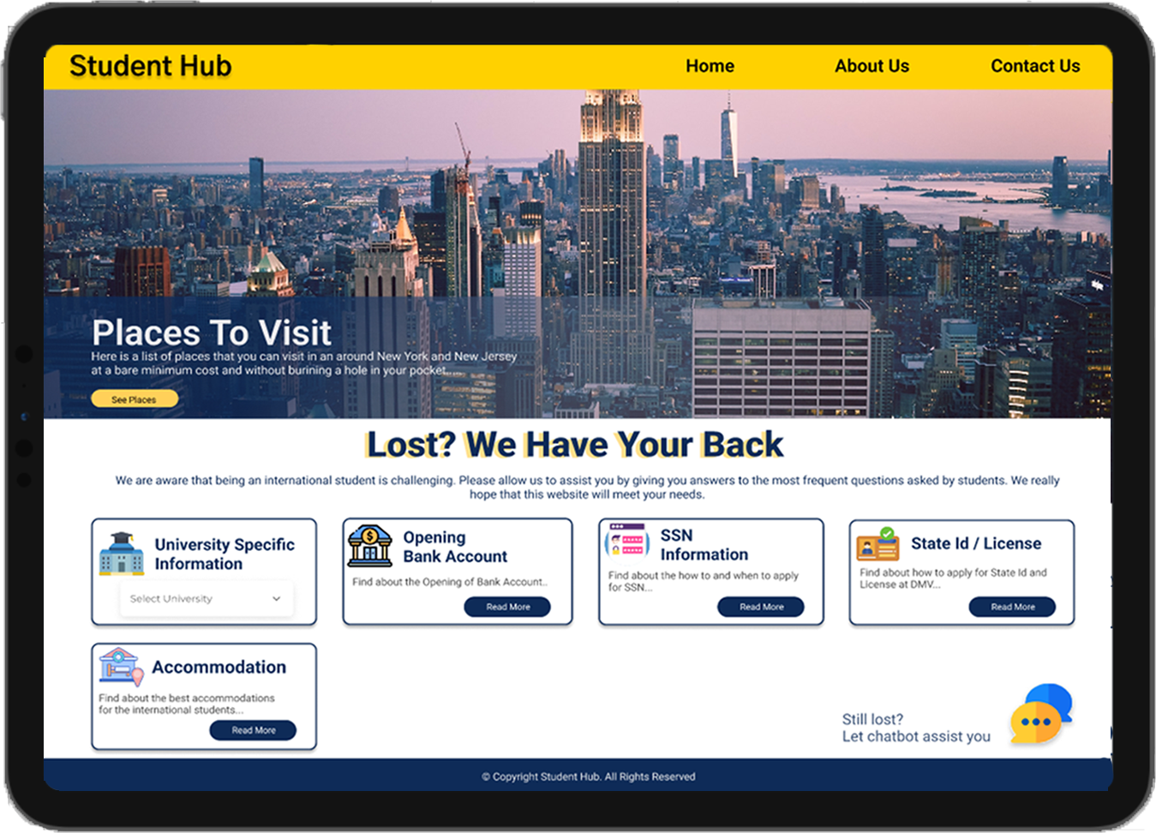
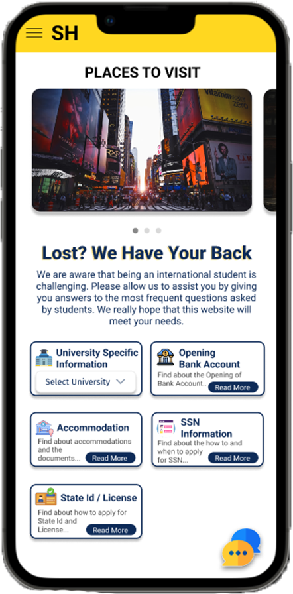
PROFESSOR: Zhan Zhang
Prepared By: Vidisha Sawant, Raj Mehta
Prashant Shinde, Neerav Poriya

Slide 2
Table of Contents
Page
Project Overview
User Research
Sketches
Wireframes / Prototypes
Usability Evaluation
Conclusions
3
4
13
16
22
31

Slide 3



Student Hub is a web application to help cater needs of International students.
Through this application we try and answer the most common questions and doubts people have in relation to various things.
It is divided into two main categories that are University centric and Non-University Centric sections.

Slide 4


Slide 5
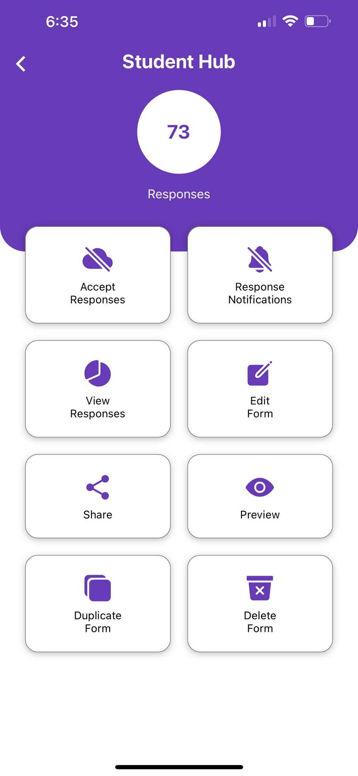
We collected quantitative and qualitative data that will help us determine the scope of our project and rank the existing needs of international students. We choose to use two research techniques:
1. Survey
2. Interview
For survey we created Google form and shared the link using WhatsApp and messages to upcoming and current students.
We received a total of 73 candidate's responses.
We interviewed 4 upcoming students and 2 current students.
We used moderated in-person interviews for current students and Zoom calls for upcoming students.
Notes:
Survey: 73 Candidates
Interview: 4 upcoming 2 current

Slide 6

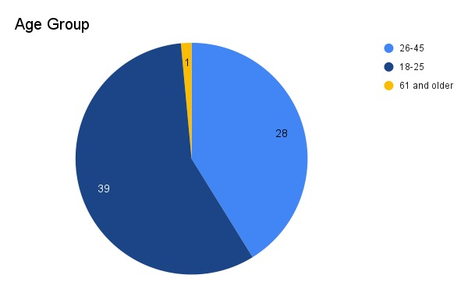
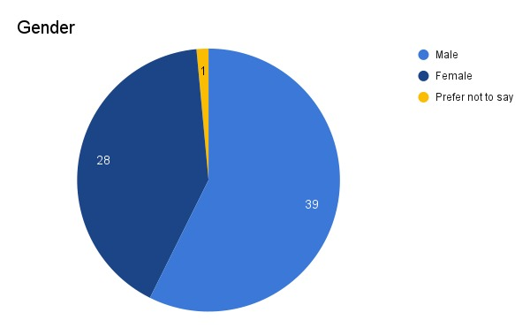
What is your gender?
Which age group defines you the best?

Slide 7


We conducted 2 interviews in-person for the current students and 4 through messages and zoom calls for upcoming students.
Amala Natu
Age | 24
Hometown | Mumbai
Vrushali More
Age | 25
Hometown | Mumbai
Yash Patel
Age | 23
Hometown | Mumbai
Mehul Jikadra
Age | 34
Hometown | Mumbai
Tushar Verma
Age | 27
Hometown | Thane, Mumbai
Alexander Kamenev
Age | 25
Hometown | Bulgaria

Slide 8
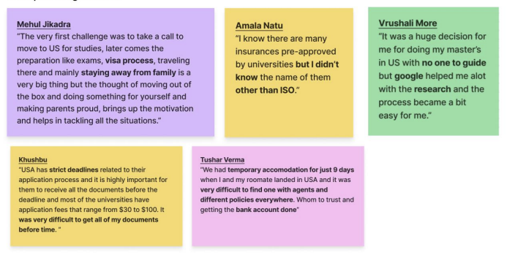

Slide 9

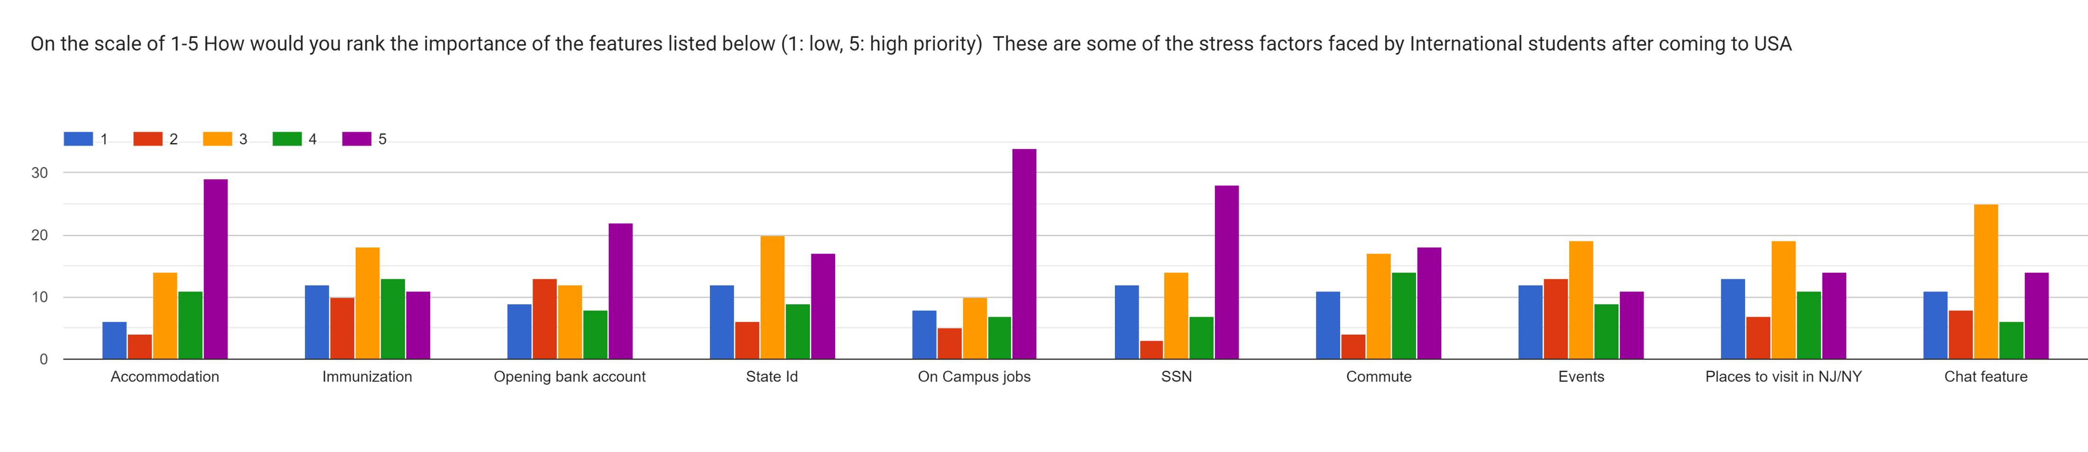
High Priority Features ( 5 )
Mentorship program page | 37
On Campus Job | 34
Accommodation | 29
SSN | 28
Opening Bank Account | 22
Mid Priority Features ( 3 )
Chat feature | 25
State Id / License | 20
Places to visit | 19
Events | 19
Immunization | 18

Slide 10
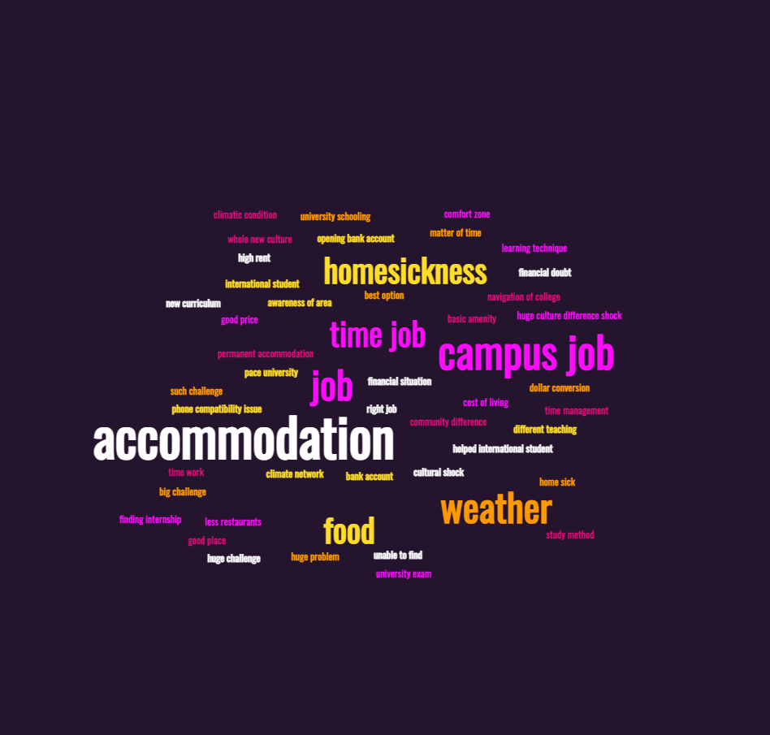
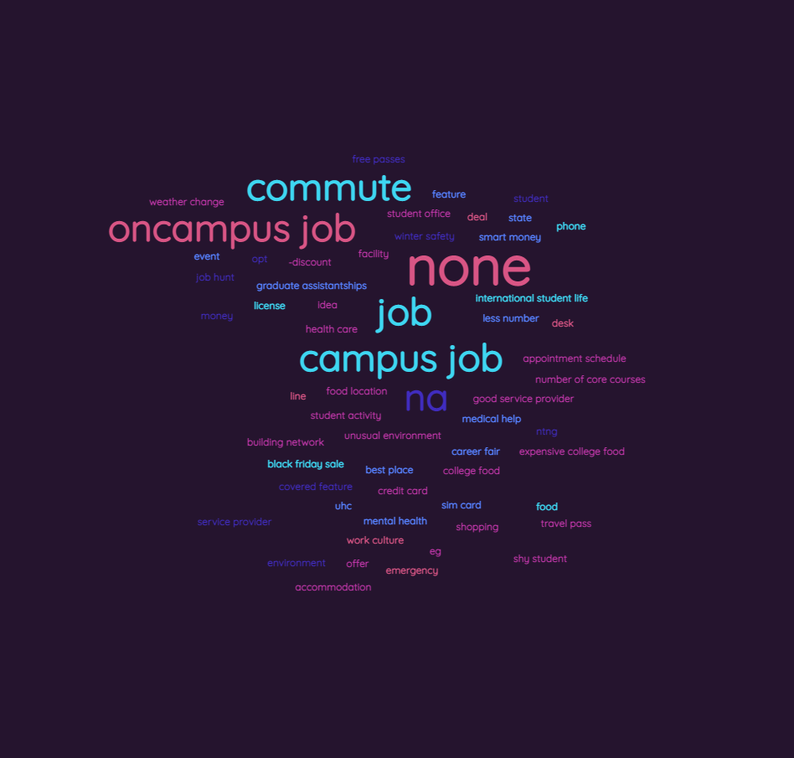
What other features than the ones listed above would you like to see in the application that you think is important?
What are the challenges after coming to the USA?

Slide 11
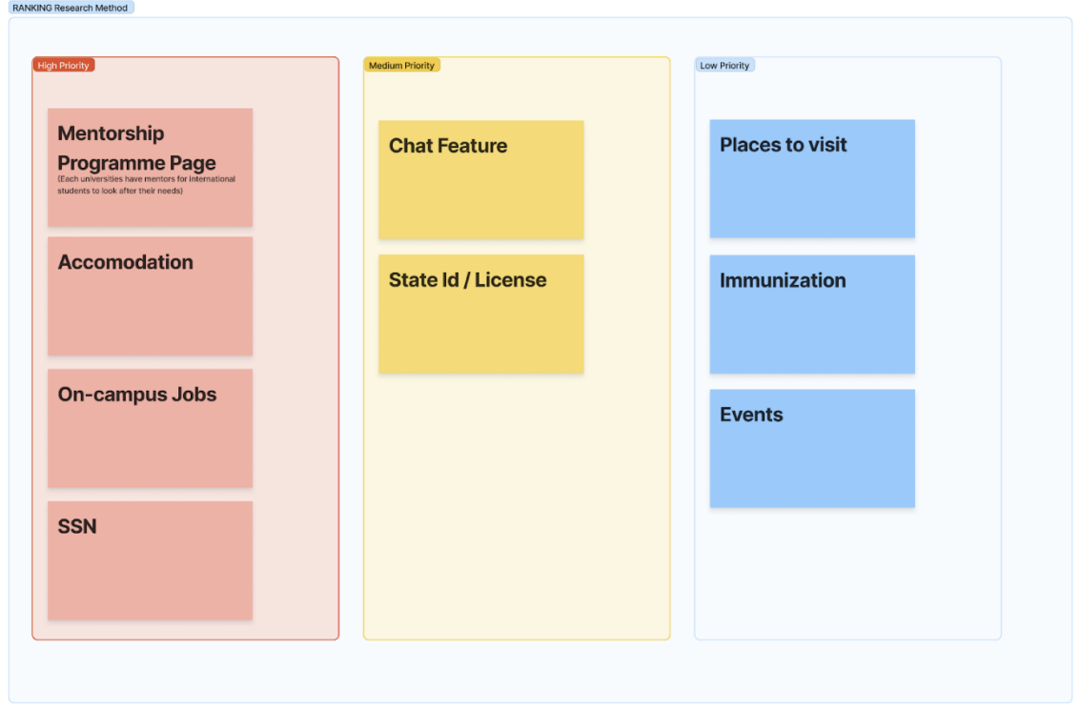
We were able to prioritize user requirements for the application based on feedback from surveys and interviews, and we used the ranking research approach to classify the necessary features into three categories:
High Priority
Medium Priority
Low Priority

Slide 12
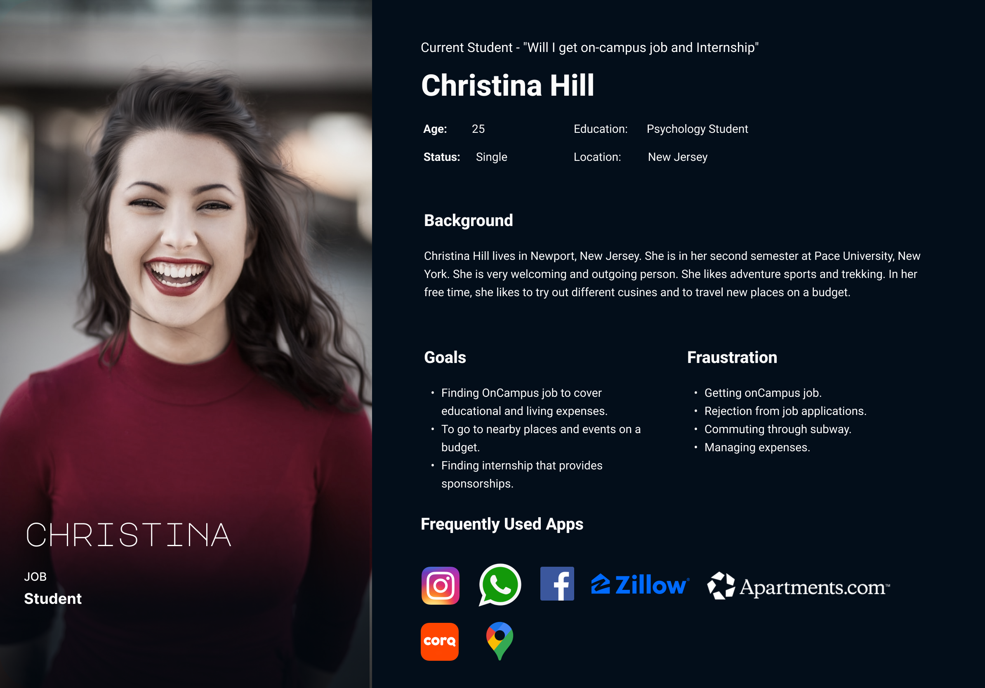

Slide 13
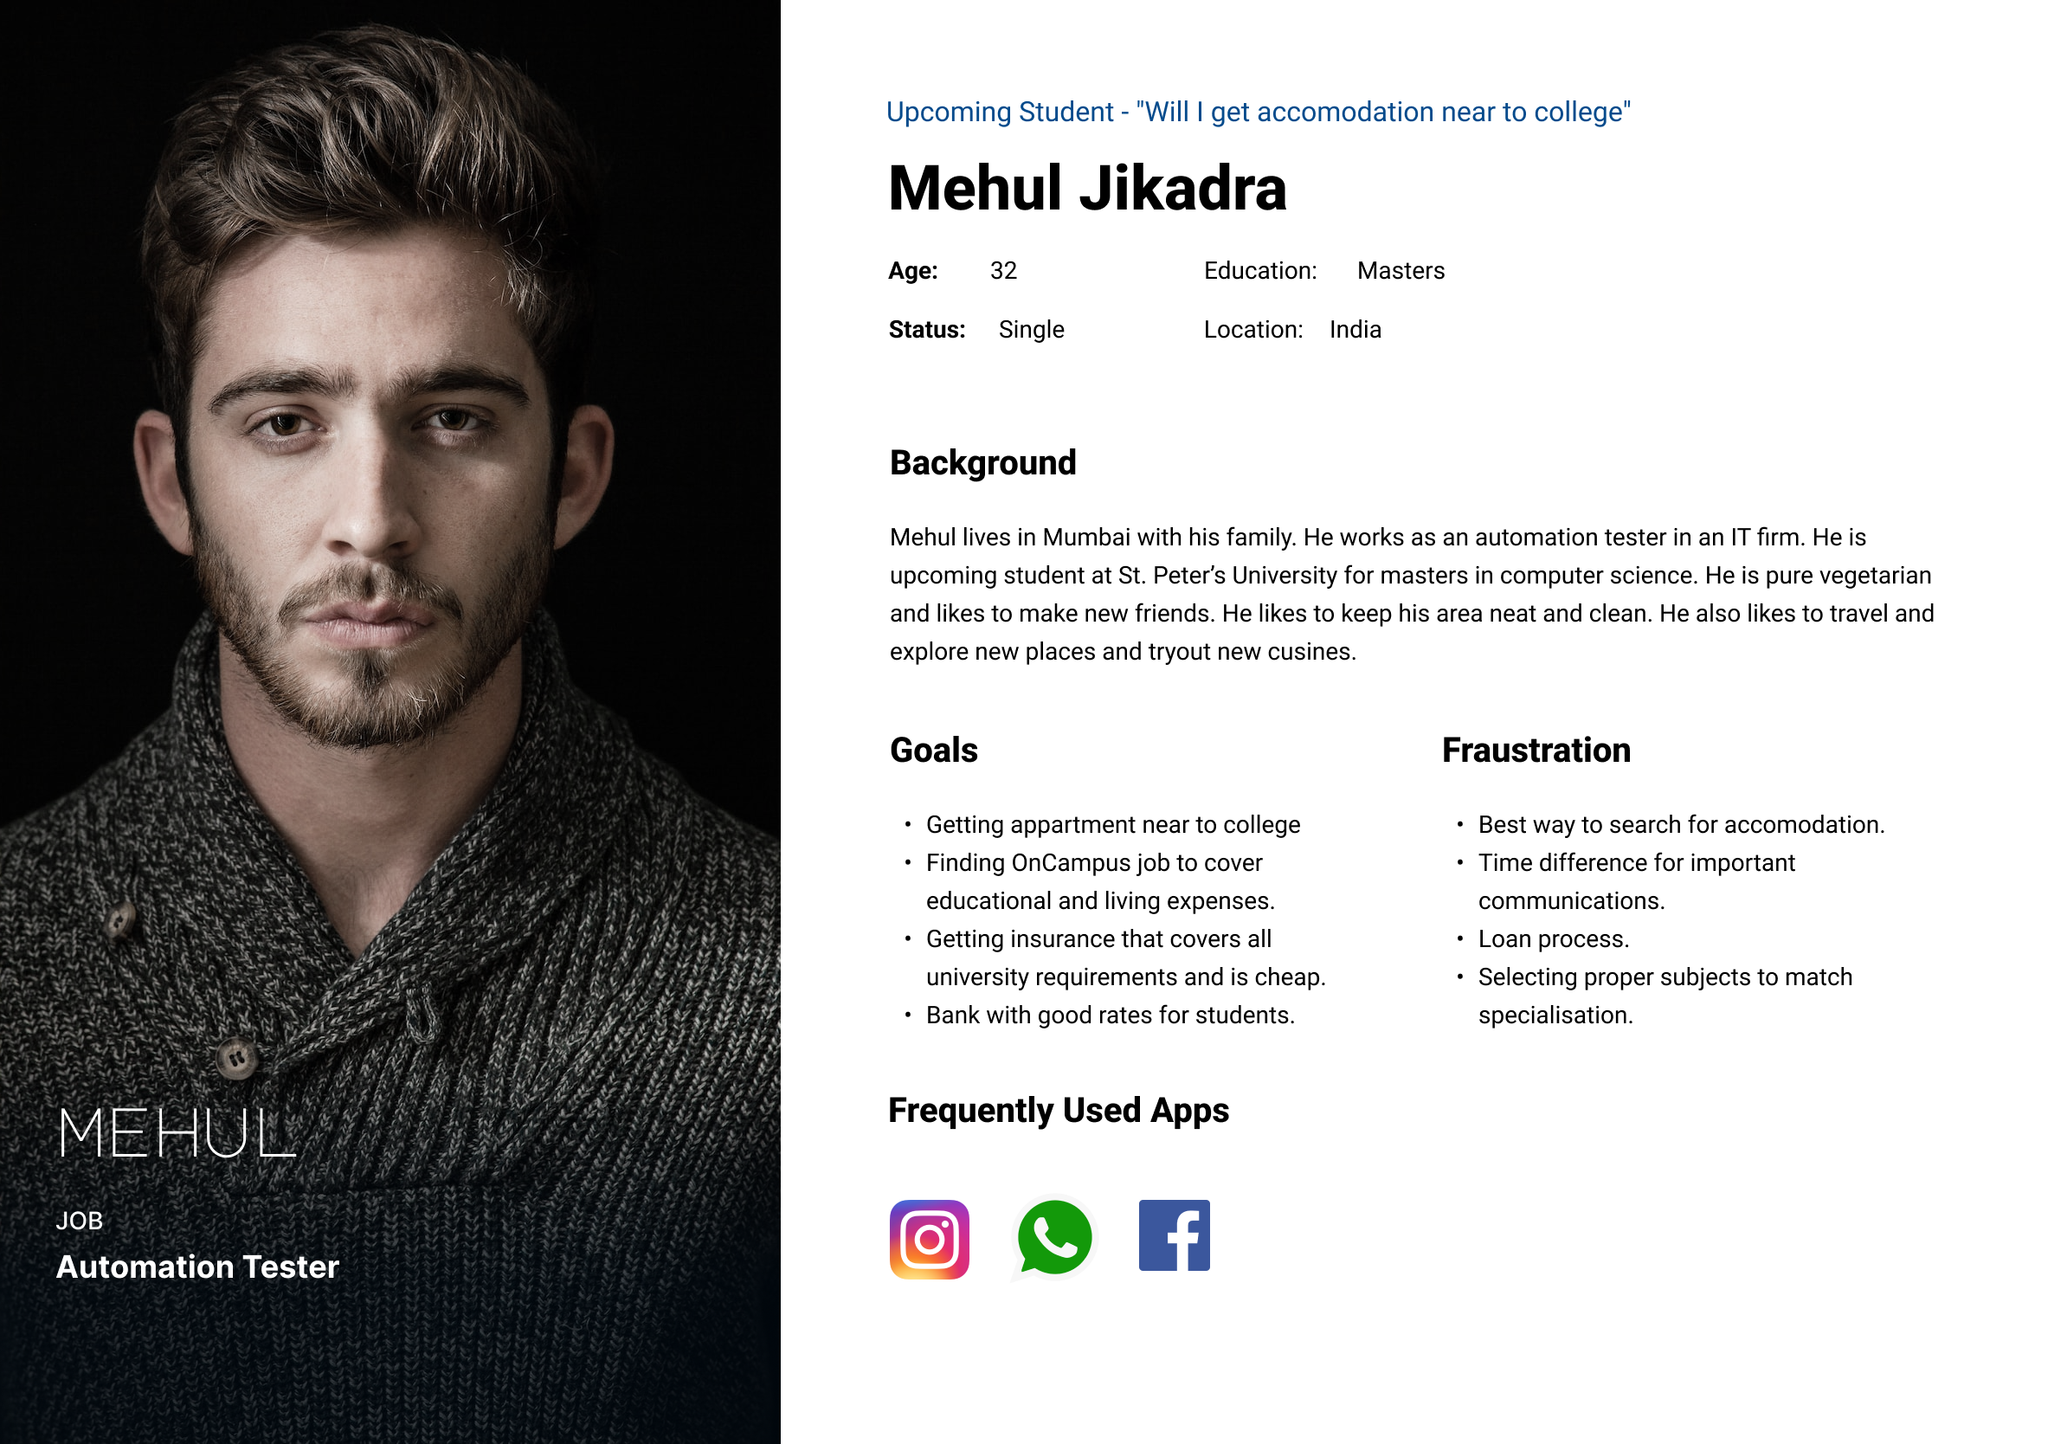

Slide 14


Slide 15

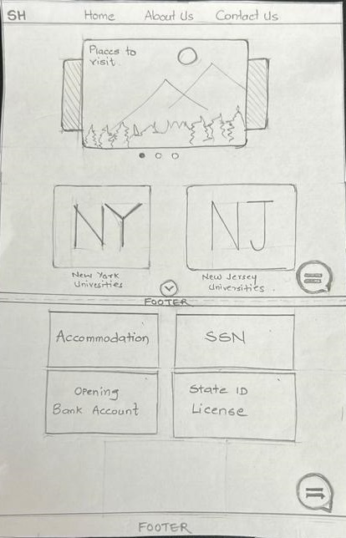
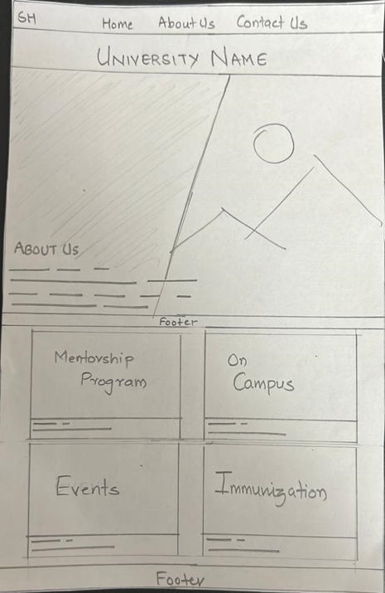
See the interactive paper sketches here.
The very first design of
Landing page. After this it went through various changes
University centric landing page, once user selects a university

Slide 16
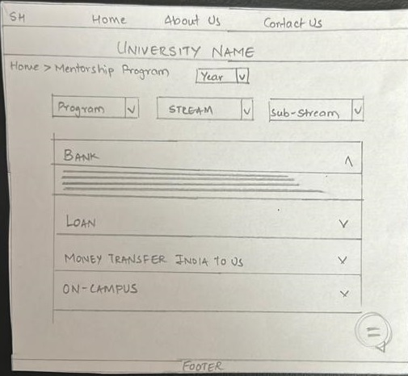
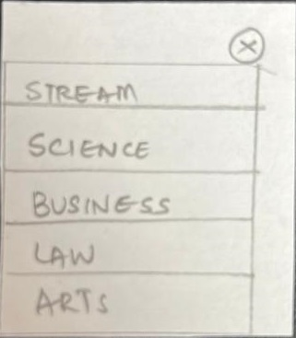
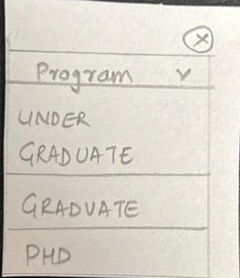
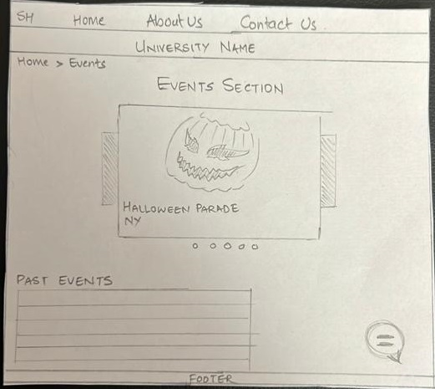
Mentorship Page
Dropdown Menus
Events Page

Slide 17


Slide 18

See the Figma prototype here.
Our goal was to make the web application interactive and easy to use. This is the reason why we decided to go with two main categories that are University centric and Non-University centric.
Our landing page is Non – University centric which consists of sub-categories such as Select University which will take you to the specific university-centric page, Opening a bank account, SSN, State id/ License, and Accommodation.
Our University Centric page consists of the Mentorship program, on-campus, Events, and Immunization.

Slide 19



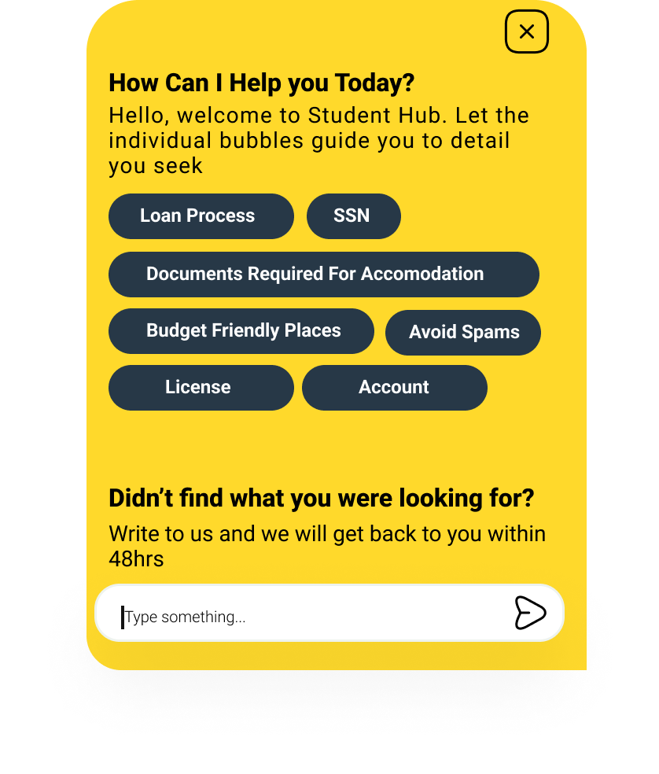
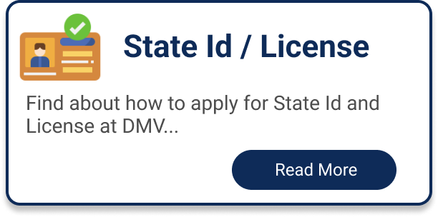

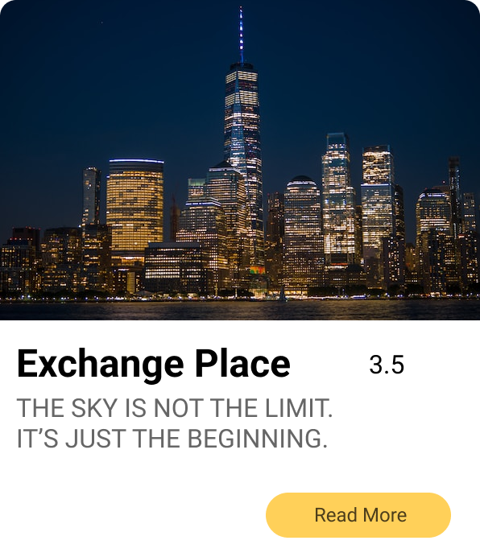

PRIMARY COLORS
BUTTON DESIGN
CHATBOT DESIGN
SECONDARY COLORS
CARD DESIGN
WEBSITE FONTS

Slide 20
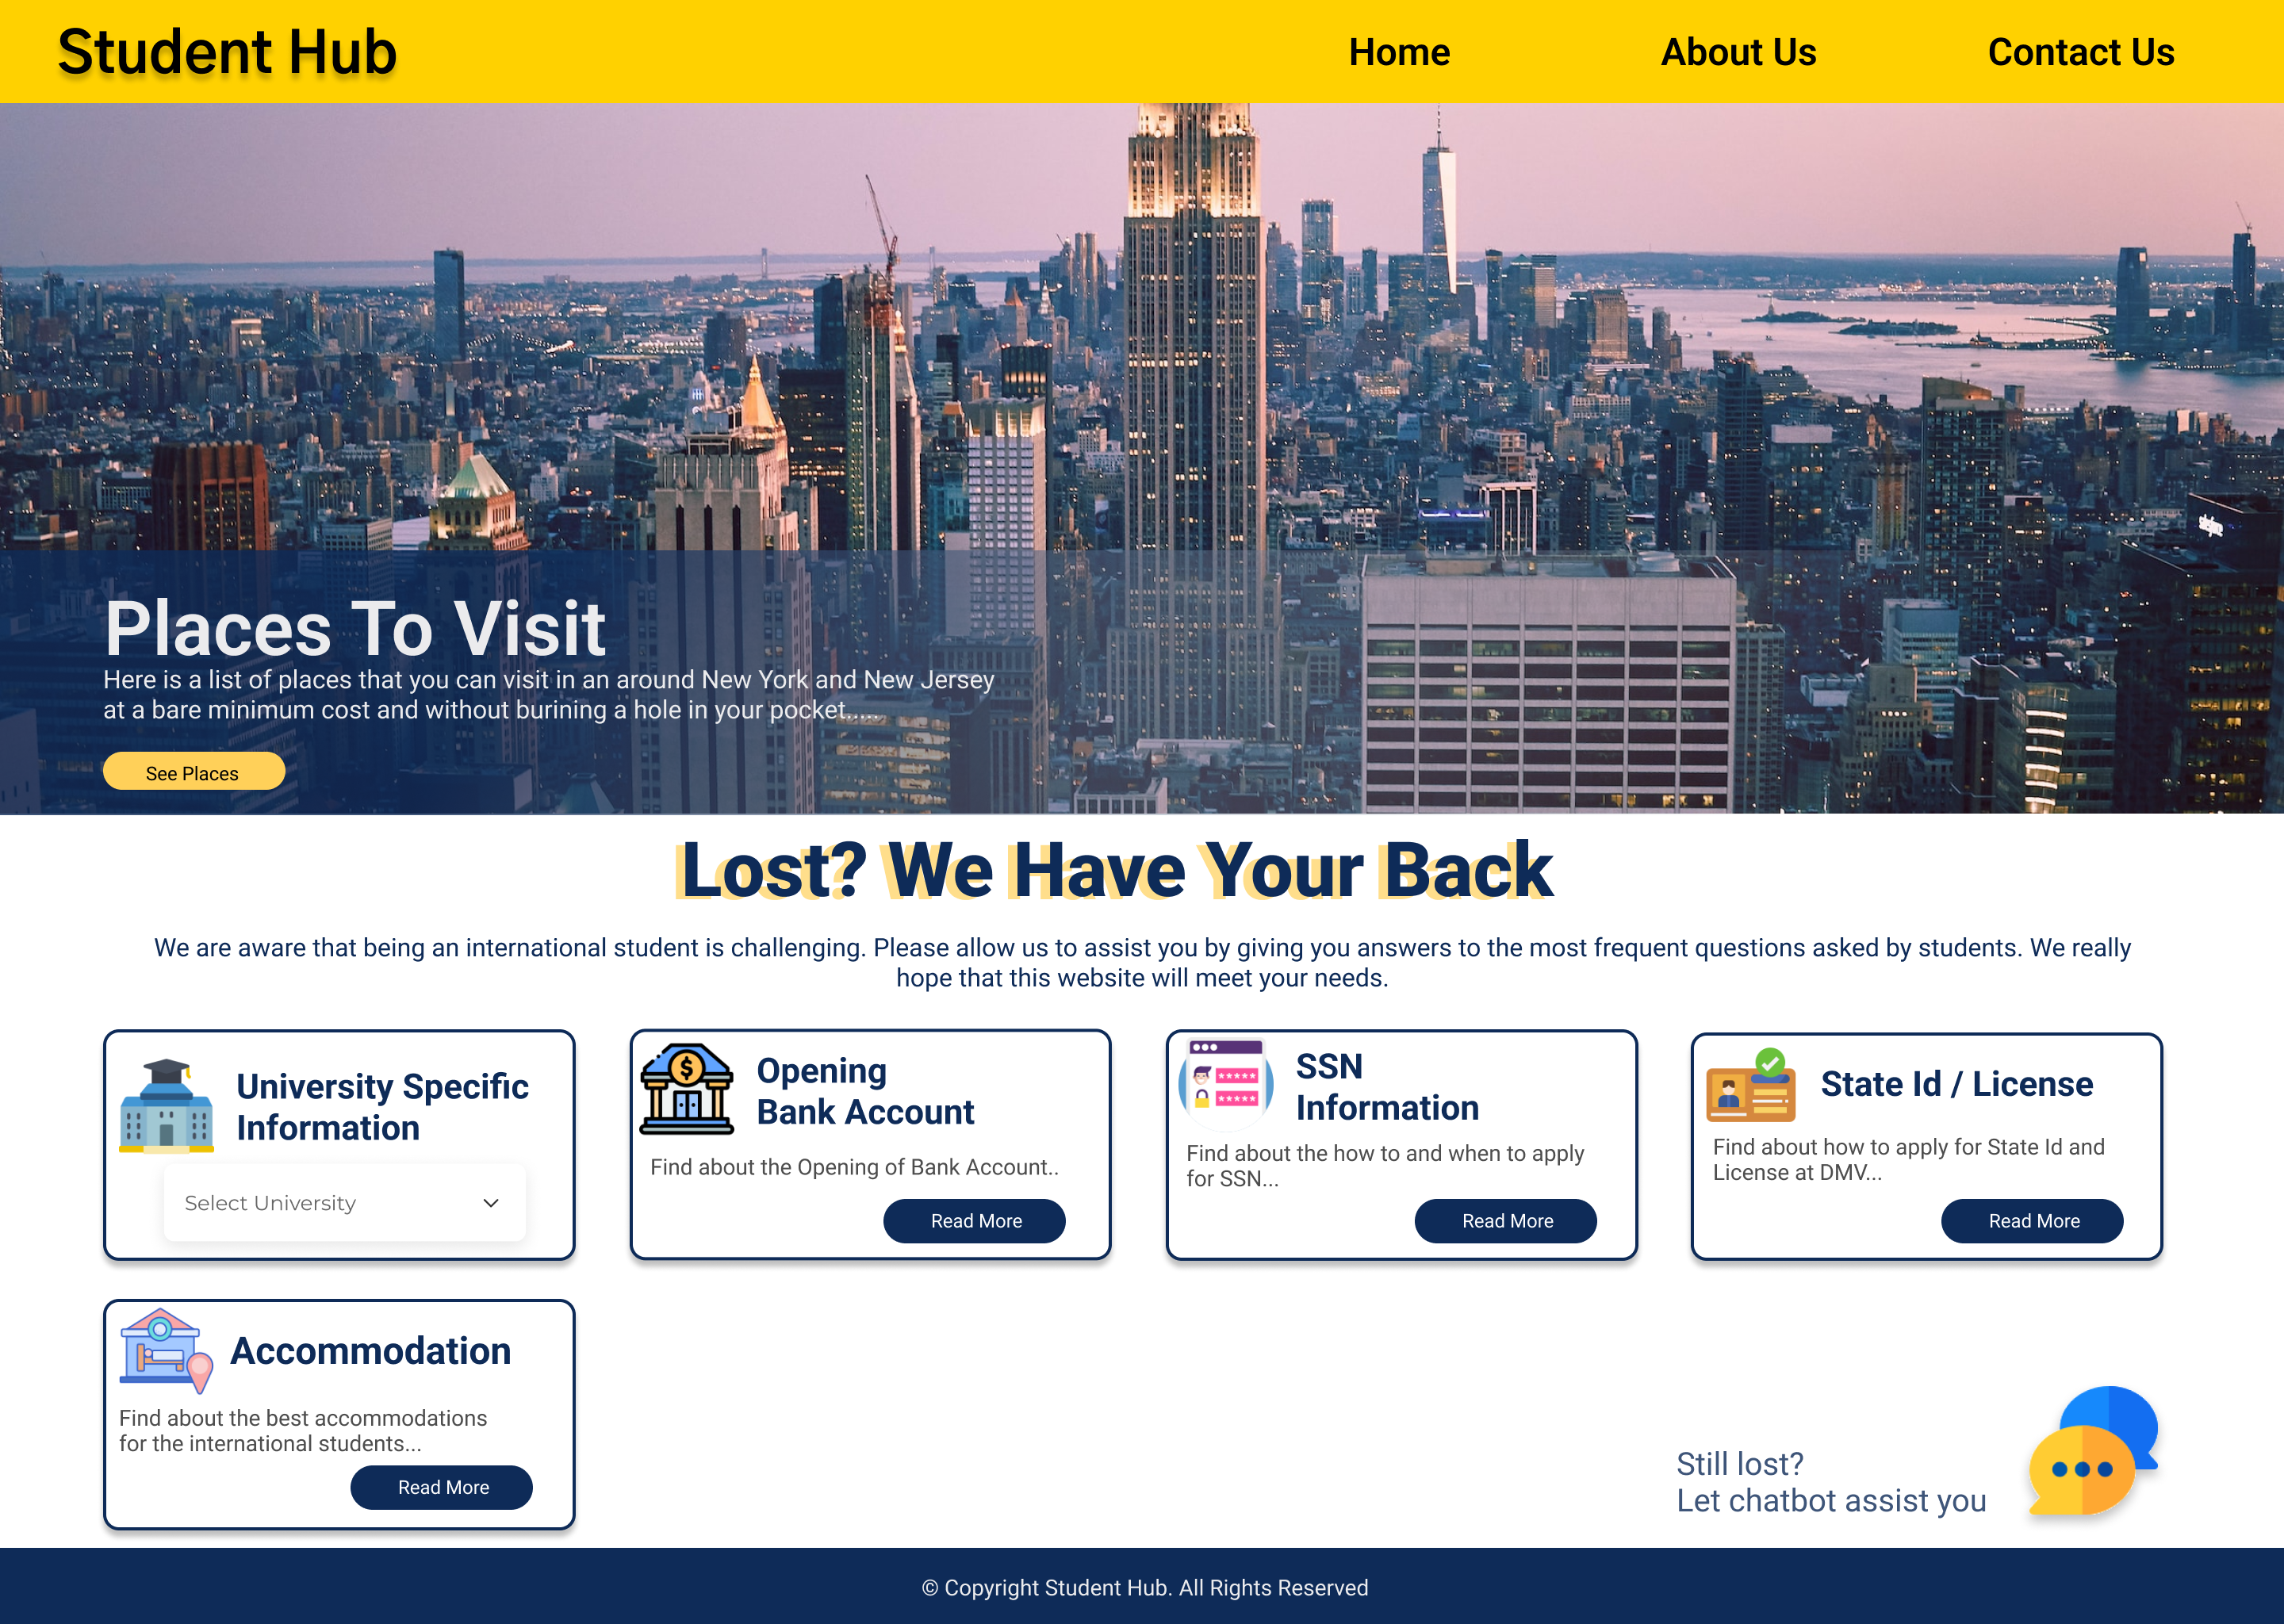
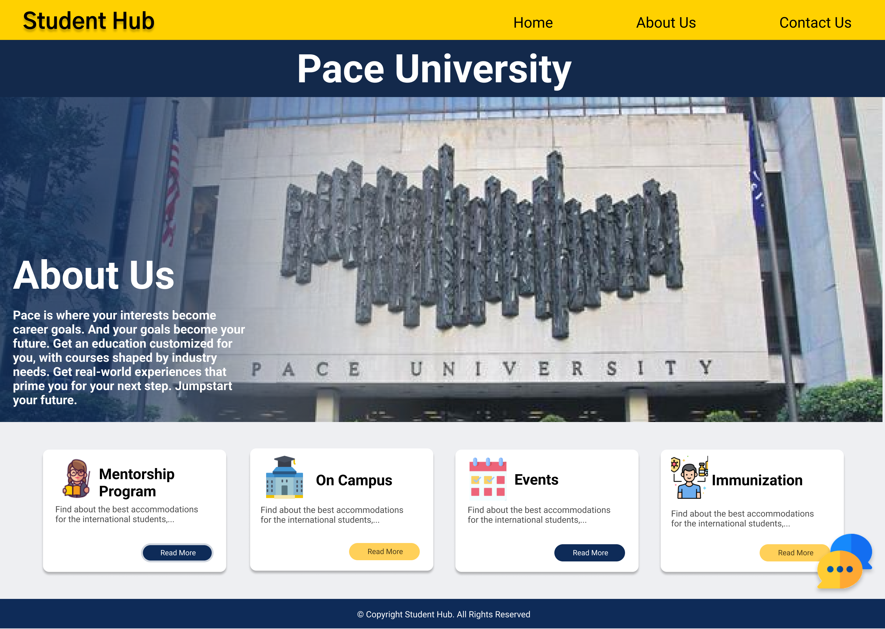

Slide 21
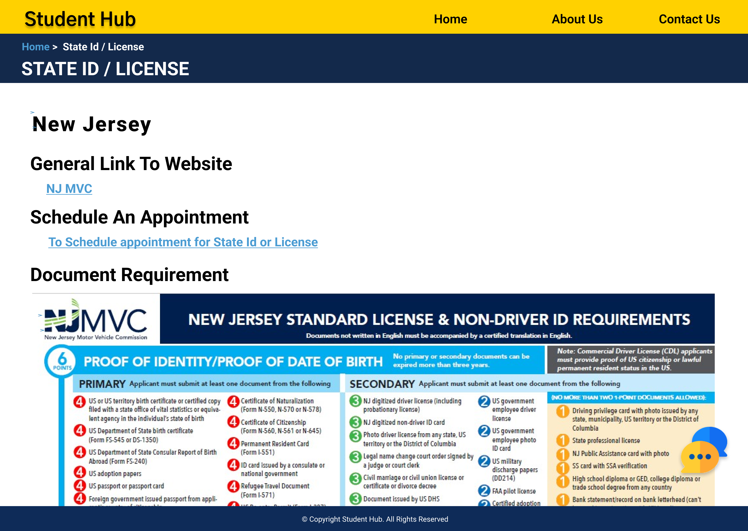
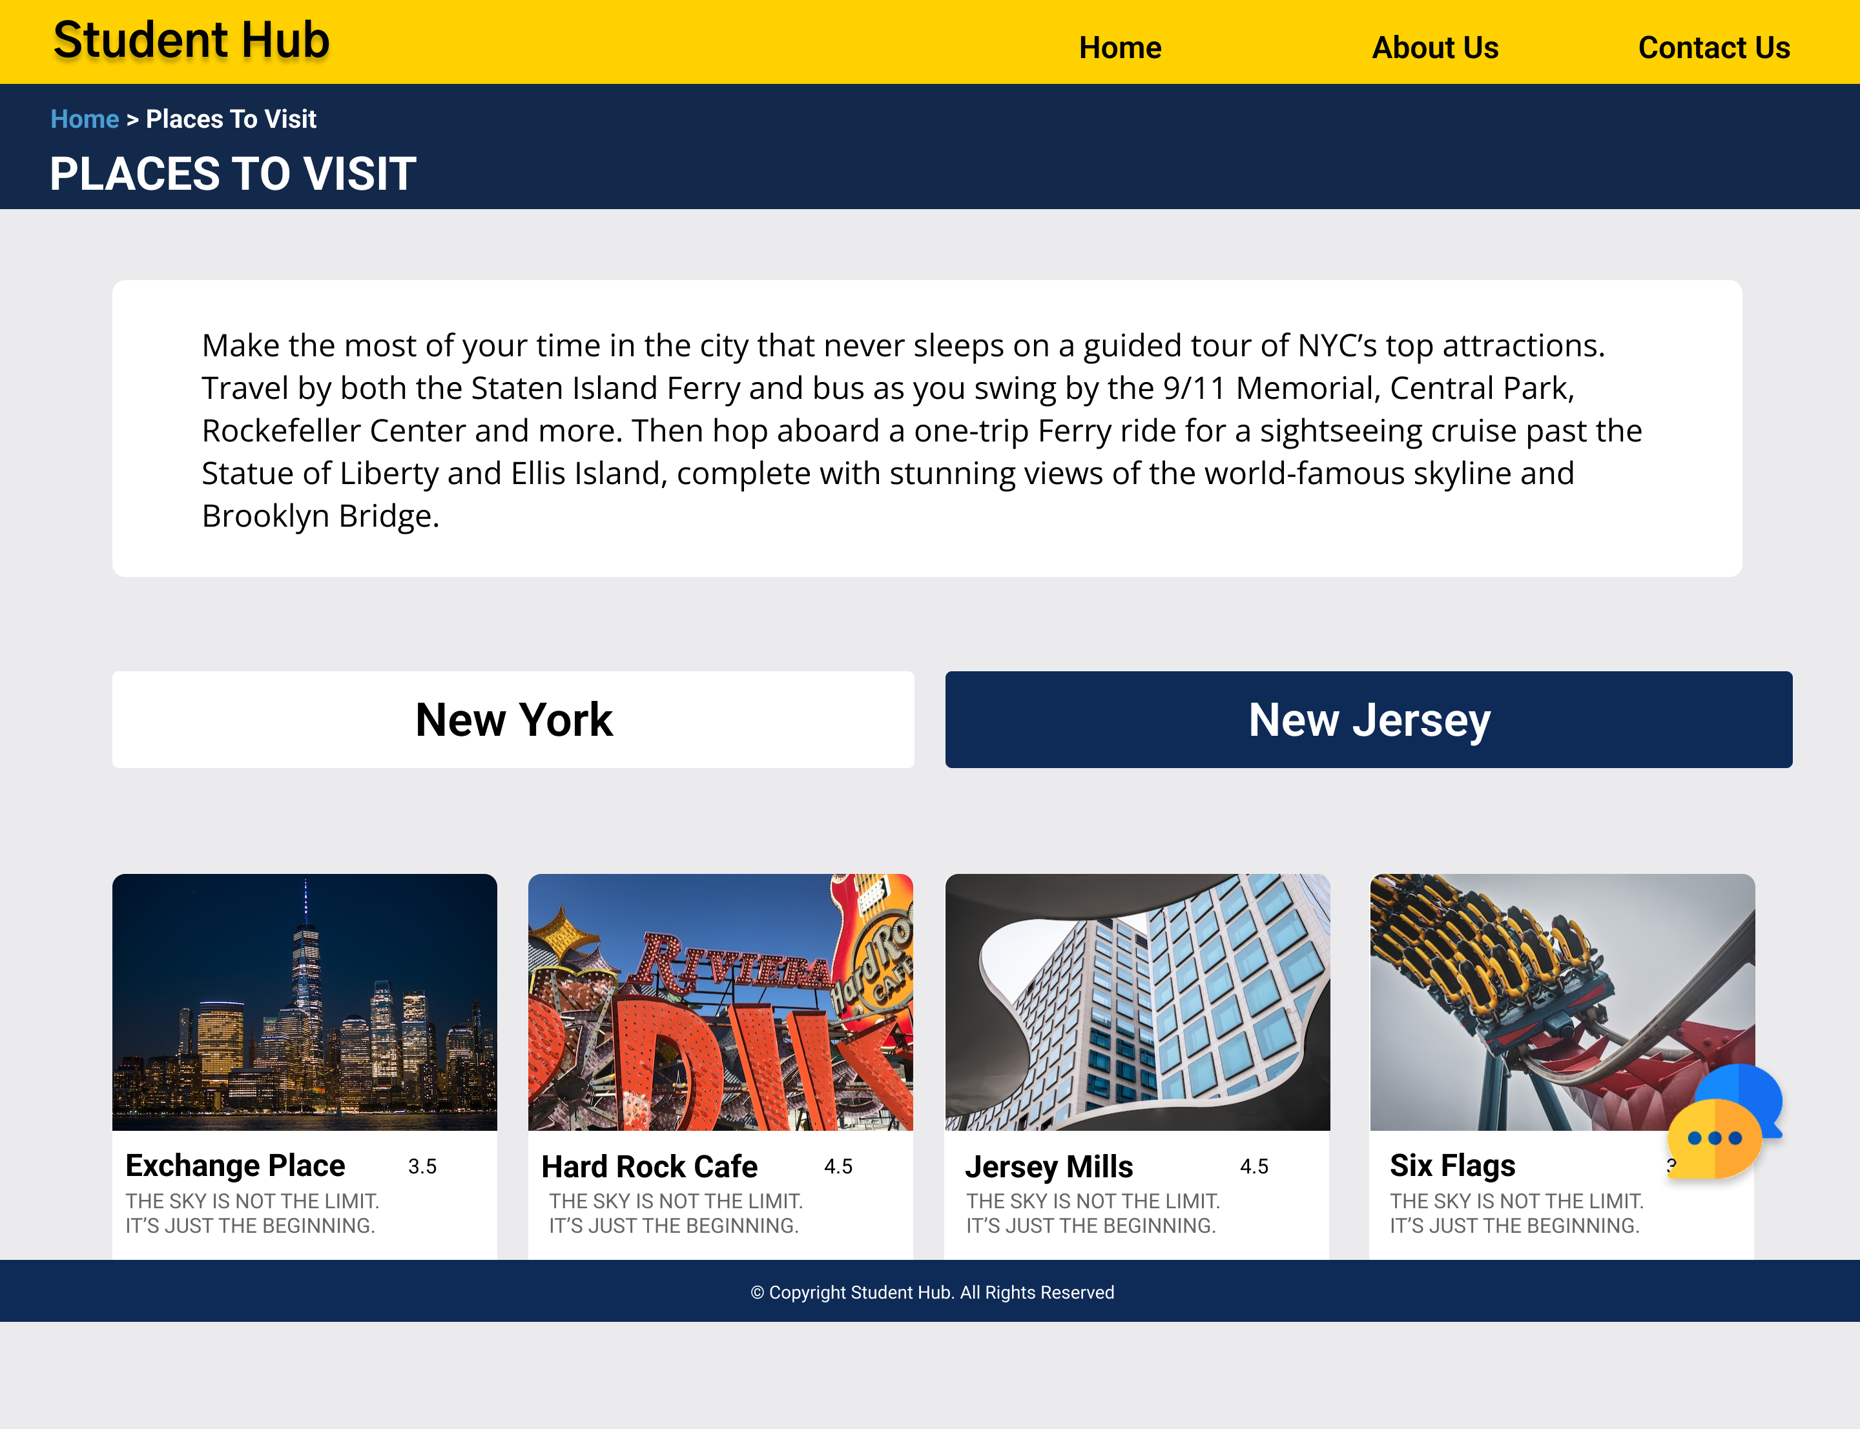
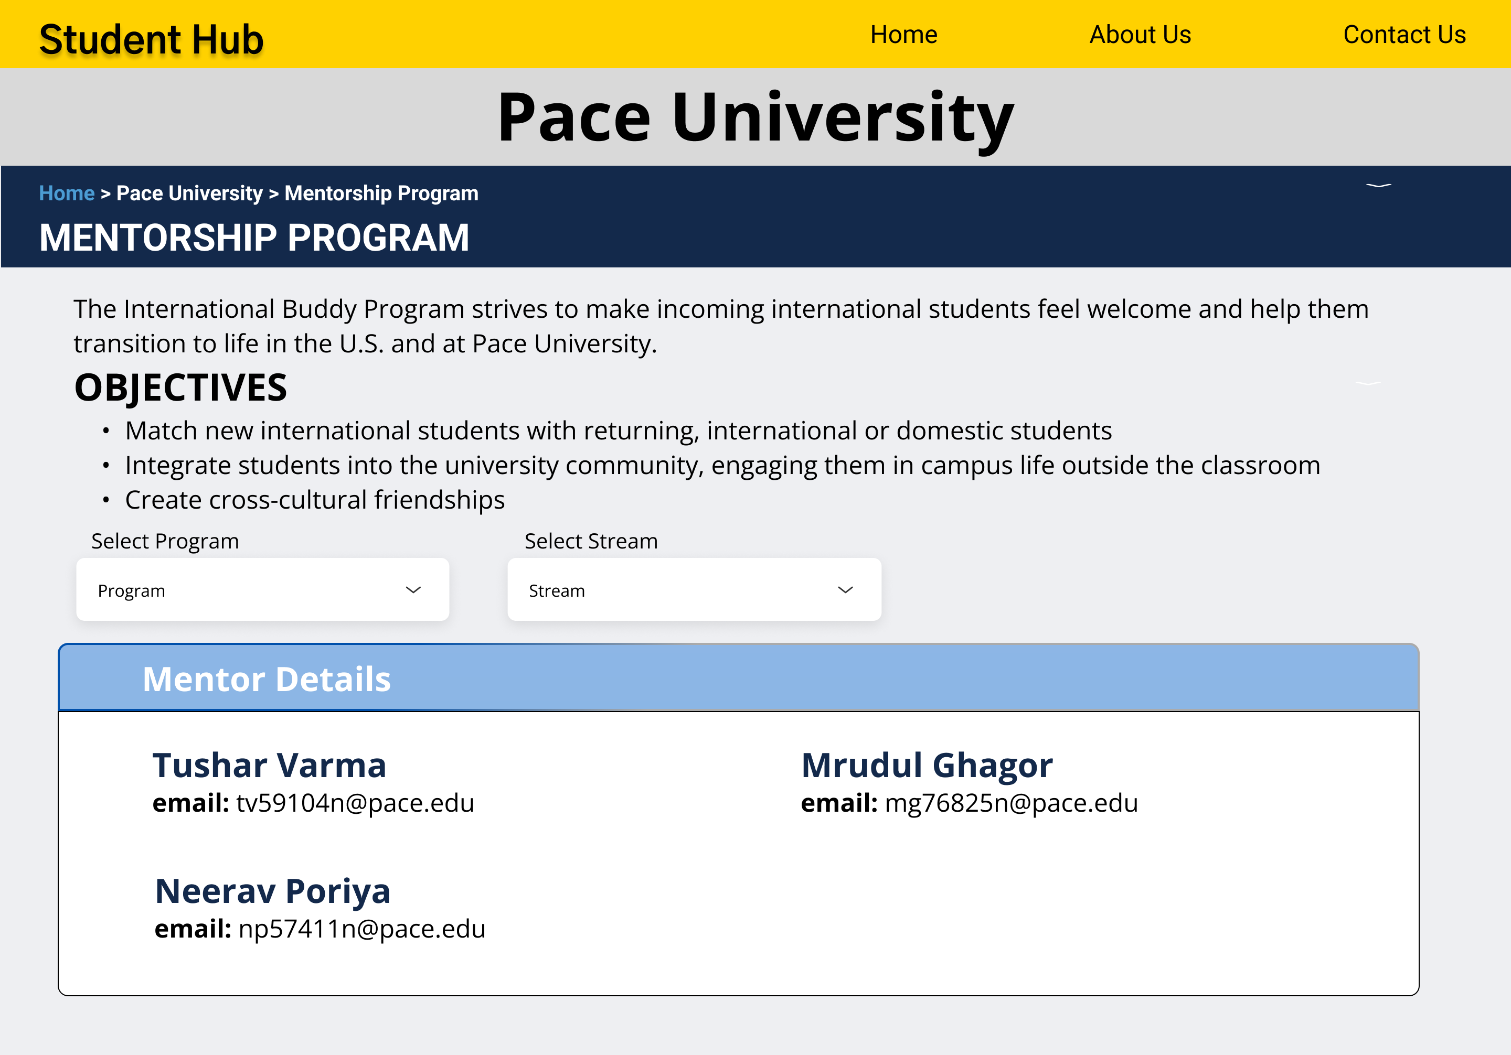
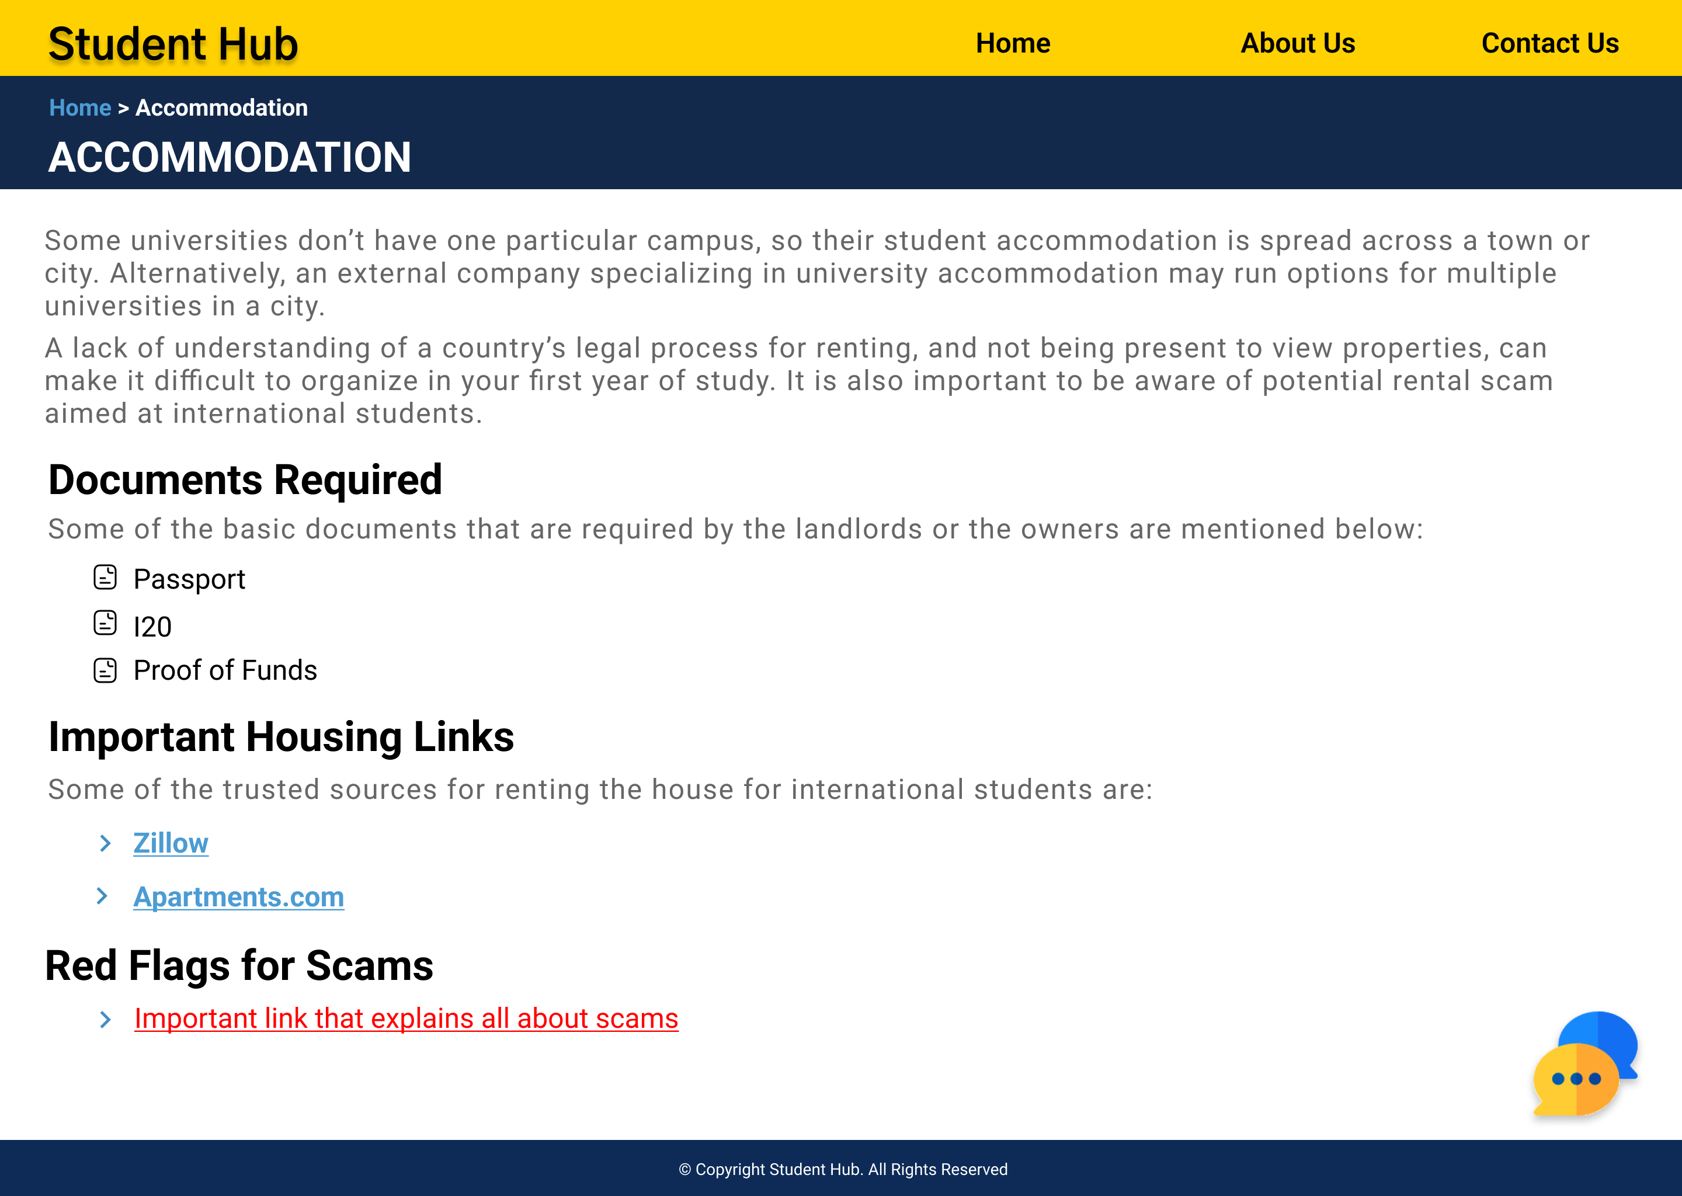

Slide 22

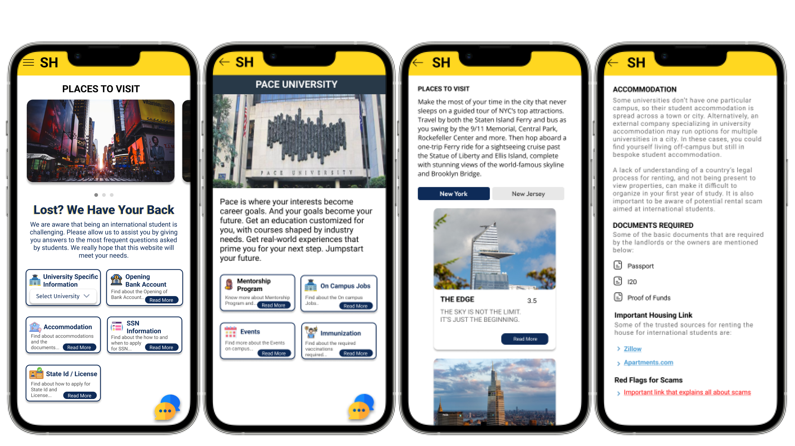

Slide 23


Slide 24


We conducted the interview via Zoom for the incoming students and on Campus interviews for the students who are already here in a moderated way.
We provided our users to perform 4 core tasks to evaluate our design.
For quantitative data, we used the SUS questionnaire were users can score on a scale of 1 – 5 where 1 being strongly disagree to 5 being strongly agree.

Slide 25
Kshitij Sharma | Time Taken Website | Time Taken Mobile | False Steps | Errors
How will you find Mentor details related to the CS stream for the Graduate Program? | 00:50 | 00:20 | None | Mentorship program?
How do I get details about red flags related to accommodation? | 00:10 | 00:07 | None
Where can I get details about Exchange Place which is very famous among Tourists? | 00:15 | 00:06 | None
How will you find link to apply for on Campus jobs for Pace University? | 00:15 | 00:12 | None
Feedbacks and Comments:
What is mentorship program?
I believe mobile and website can have different looks till the time it is functional and doing the work accurately.
Aishwarya Nair | Time Taken Website | Time Taken Mobile | False Steps | Errors
How will you find Mentor details related to the CS stream for the Graduate Program? | 01:00 | 00:22 | None
How do I get details about red flags related to accommodation? | 00:15 | 00:06 | None | What do we mean by red flag?
Where can I get details about Exchange Place which is very famous among Tourists? | 00:22 | 00:10 | None
How will you find link to apply for on Campus jobs for Pace University? | 00:15 | 00:09 | None
Feedbacks and Comments:
Why do we have this chatbot feature when we have same bubbles outside. (On explaining, that chatbot will also have non prominent features and bubbles that are not already covered and if you feel like we missed something, you can convey the same to us) agreed the use of it.
I believe mobile and website should look the same, yes less information to display on mobile upfront but design wise they should be same.

Slide 26

Neha Chudekar | Time Taken Website | Time Taken Mobile | False Steps | Errors
How will you find Mentor details related to the CS stream for the Graduate Program? | 00:25 | 00:20 | None
How do I get details about red flags related to accommodation? | 00:10 | 00:07 | None
Where can I get details about Exchange Place which is very famous among Tourists? | 00:15 | 00:06 | None
How will you find link to apply for on Campus jobs for Pace University? | 00:15 | 00:12 | None
Feedbacks and Comments:
Felt that major points were covered.
Would like to have the loan feature bubble prominent.
Aishwarya Suresh | Time Taken Website | Time Taken Mobile | False Steps | Errors
How will you find Mentor details related to the CS stream for the Graduate Program? | 00:20 | 00:18 | None
How do I get details about red flags related to accommodation? | 00:15 | 00:11 | None
Where can I get details about Exchange Place which is very famous among Tourists? | 00:25 | 00:10 | None
How will you find link to apply for on Campus jobs for Pace University? | 00:20 | 00:15 | None
Feedbacks and Comments:
Felt that major points were covered.
Wanted transfer money to India feature bubble.
Wanted paying money to university feature.

Slide 27

Access to SUS questions here.
The SUS score was calculated by the matrix of
For every odd-numbered question, subtract 1 from the score (X-1)
For every even-numbered question, subtract the score from 5 (5-X)
Sum the scores from even and odd-numbered questions. Then multiply the total with 2.5

Slide 28
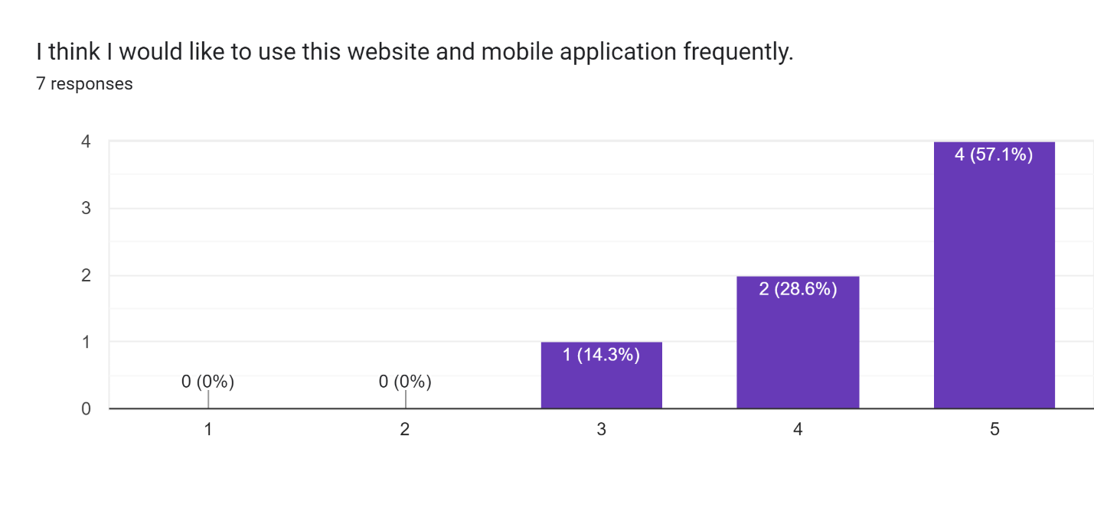
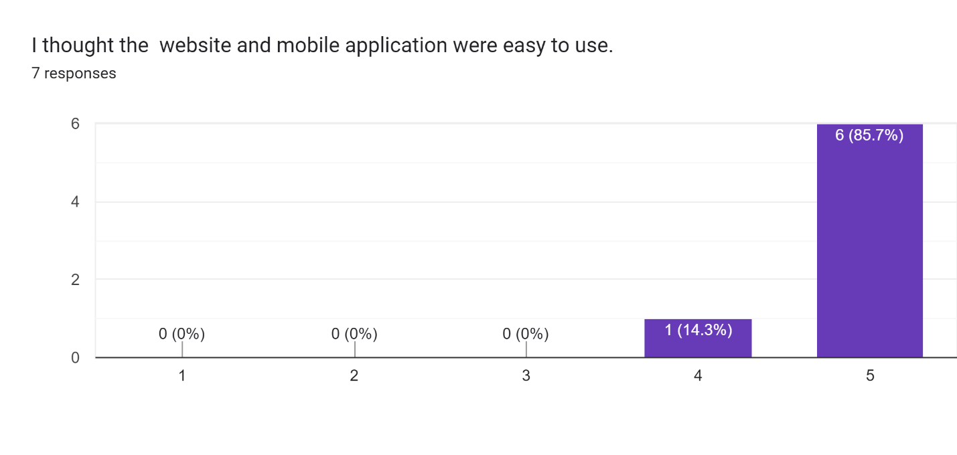
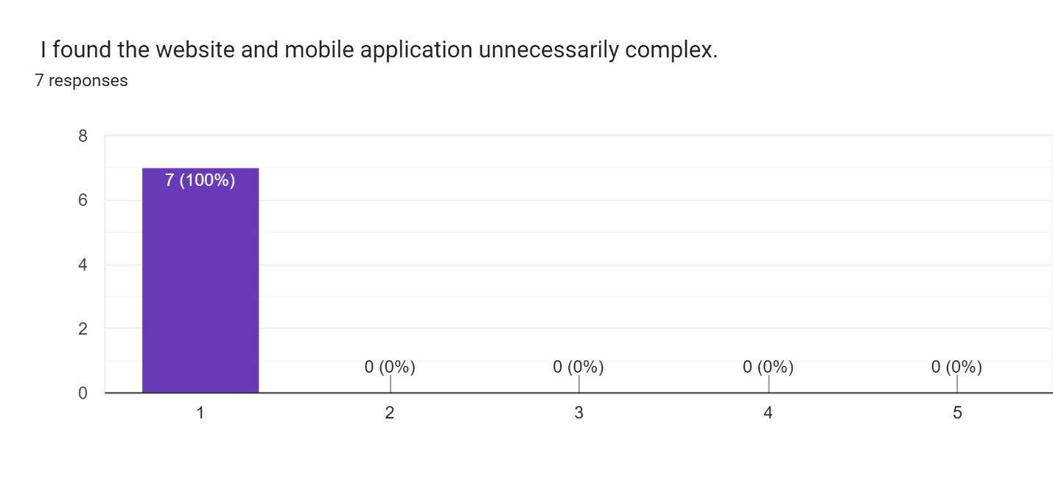
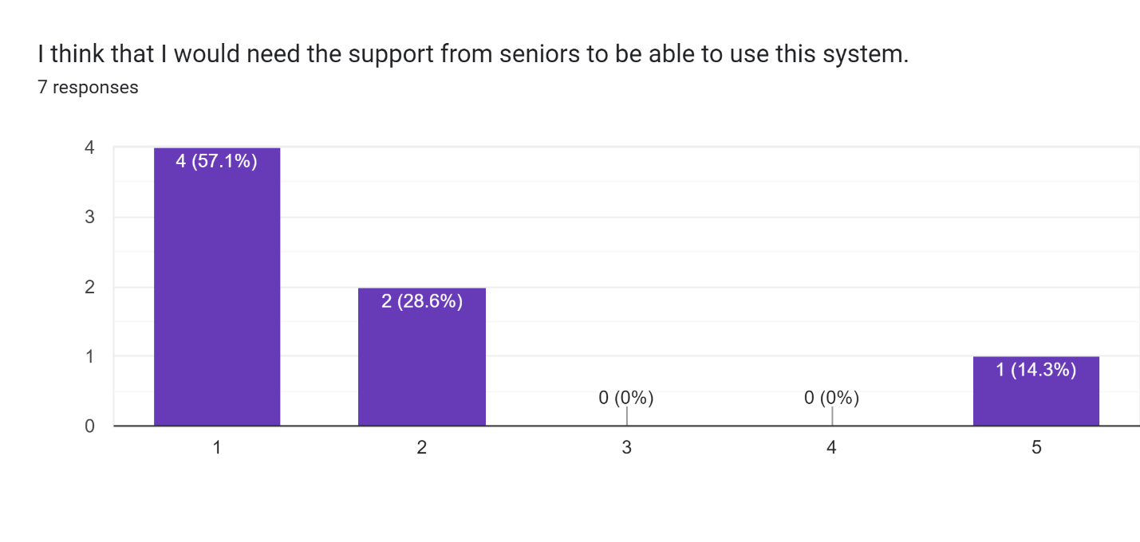

Slide 29
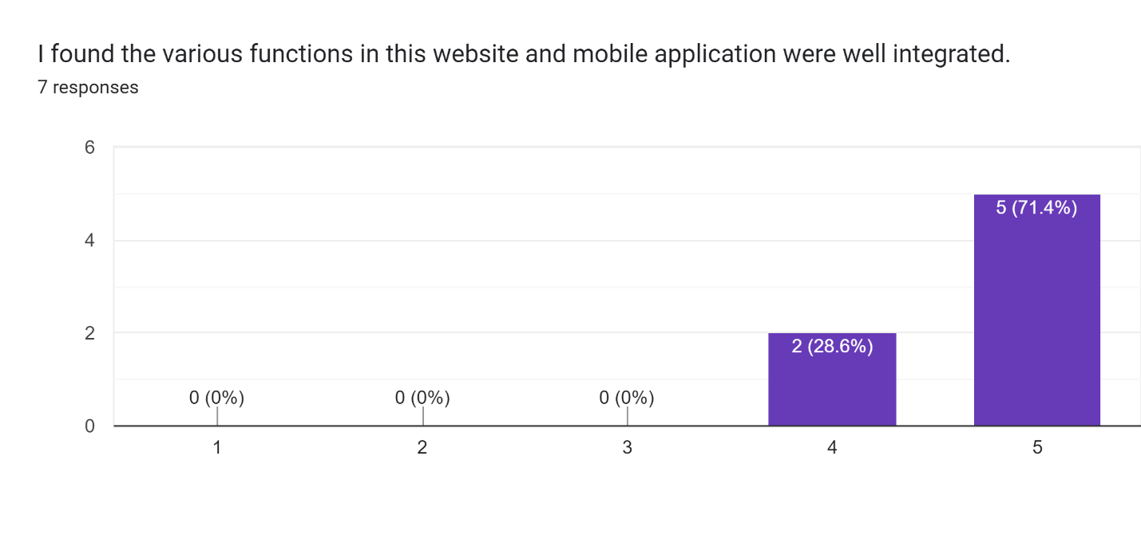
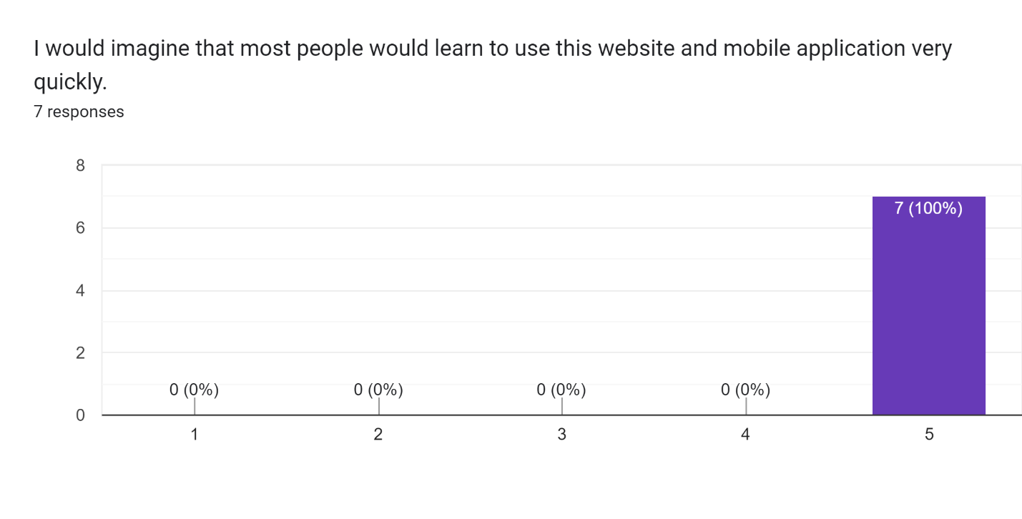
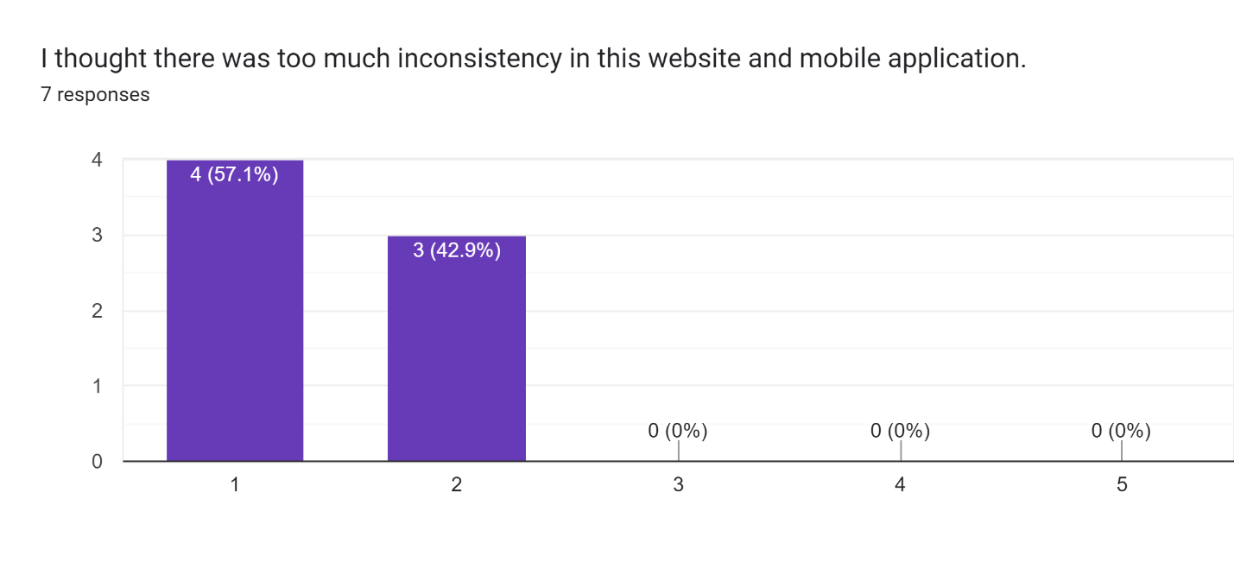
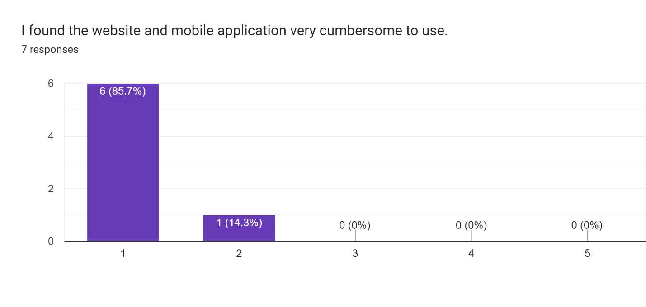

Slide 30
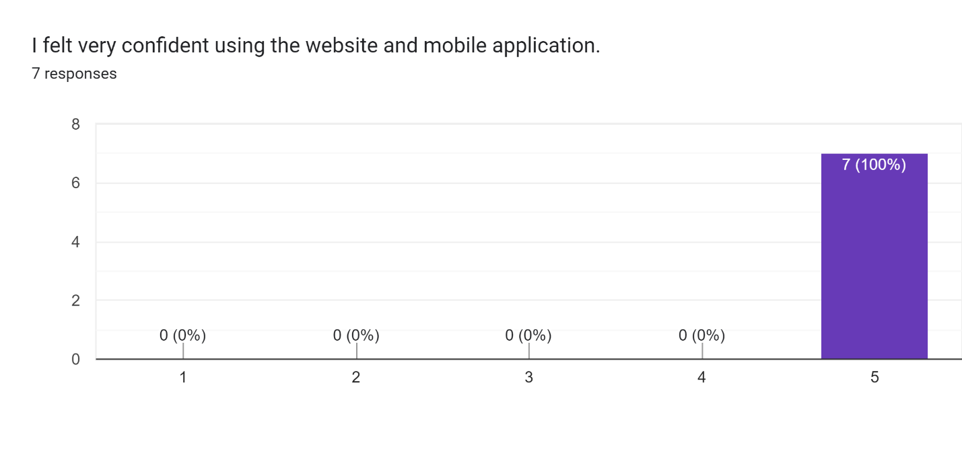
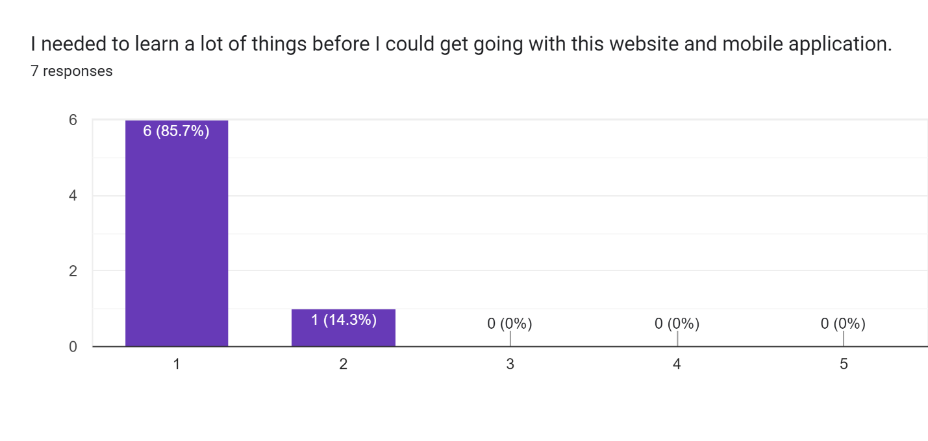


Slide 31

According to Usability.gov, a SUS score above a 68 is considered average, and anything below is considered below average. You could also group the number of scores you receive to determine what percentage of respondents gave you a high or low score.
The image below gives you a better snapshot of the range of scores and what they mean. In general:
Scores below 50 are considered 'Not Acceptable'
Scores between 51-70 are considered 'Marginal'
Scores above 71 are considered 'Acceptable'
 | 1 | 2 | 3 | 4 | 5 | 6 | 7 | 8 | 9 | 10 | SUS Raw Score | SUS Final Score
User 1 | 5 | 1 | 5 | 5 | 5 | 2 | 5 | 1 | 5 | 1 | 35 | 87.5
User 2 | 4 | 1 | 4 | 1 | 5 | 1 | 4 | 1 | 4 | 1 | 36 | 90
User 3 | 4 | 1 | 5 | 1 | 4 | 2 | 5 | 1 | 5 | 1 | 37 | 92.5
User 4 | 5 | 1 | 5 | 2 | 5 | 1 | 5 | 1 | 5 | 2 | 38 | 95
User 5 | 3 | 1 | 4 | 2 | 4 | 1 | 5 | 1 | 5 | 1 | 35 | 87.5
User 6 | 4 | 1 | 5 | 1 | 5 | 1 | 5 | 1 | 5 | 1 | 39 | 97.5

Slide 32


Slide 33


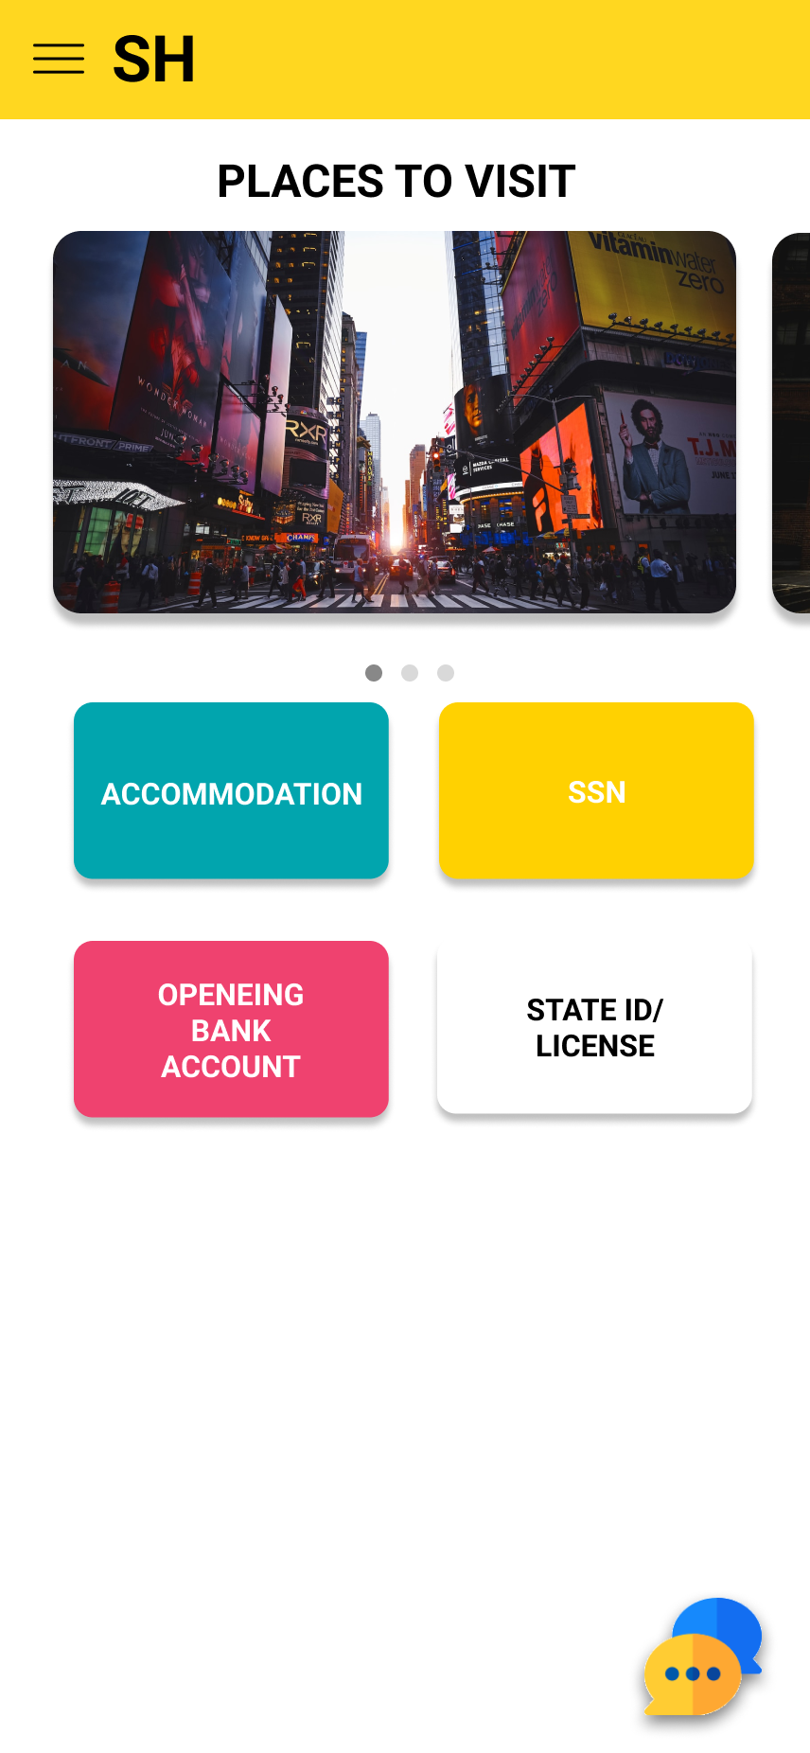
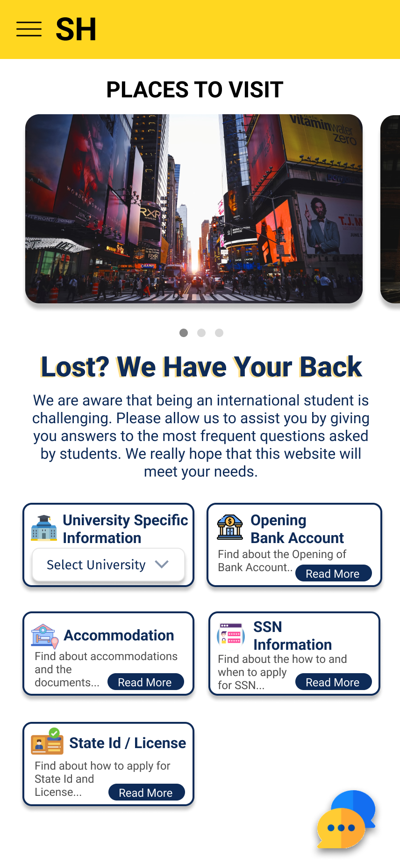
Mobile and Website view should be identical (5 out of 6 users stressed on this point), even though the functioning and content were properly placed but they did notice the design change and would like to have similar design carried in the mobile app as well.
Prior To Changes
After Changes

Slide 34
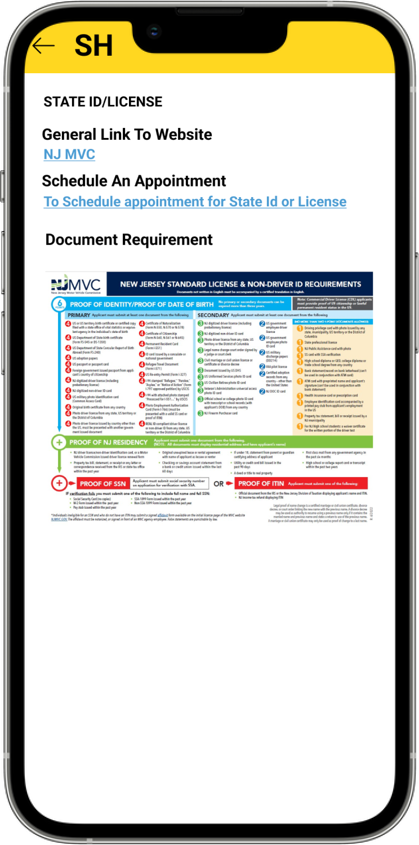
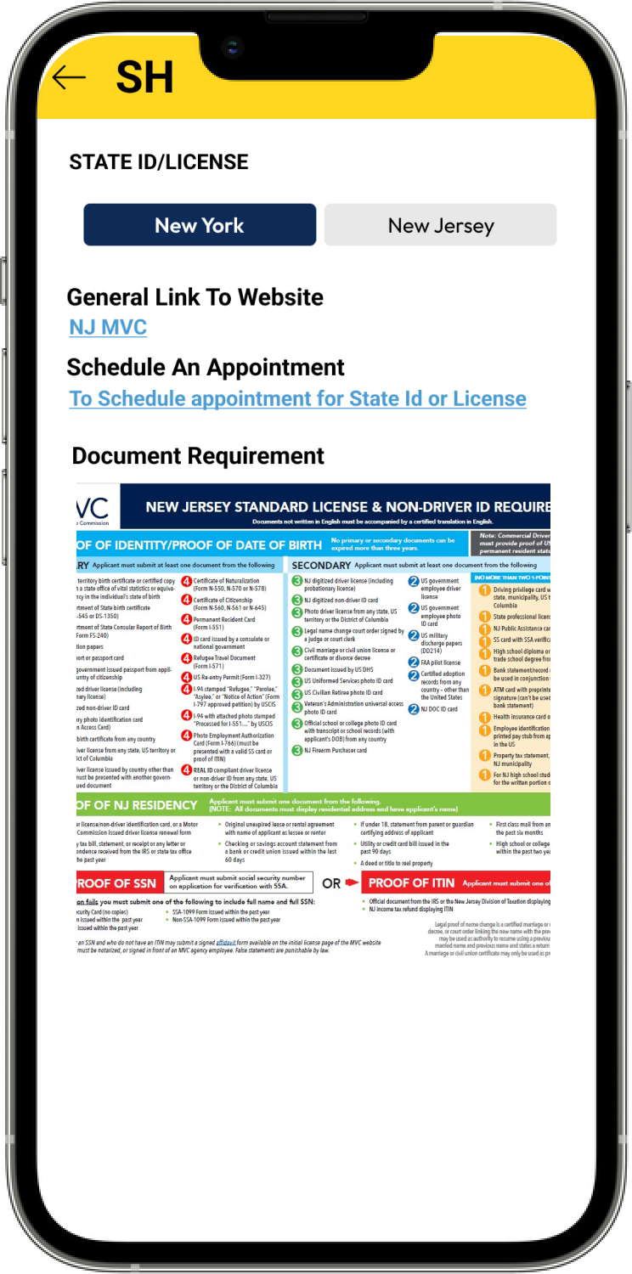

State Id / License page: 2 users said that they would love to have a tab feature to select between New Jersey and New York, instead of scrolling to find a particular information.
Prior To Changes
After Changes

Slide 35
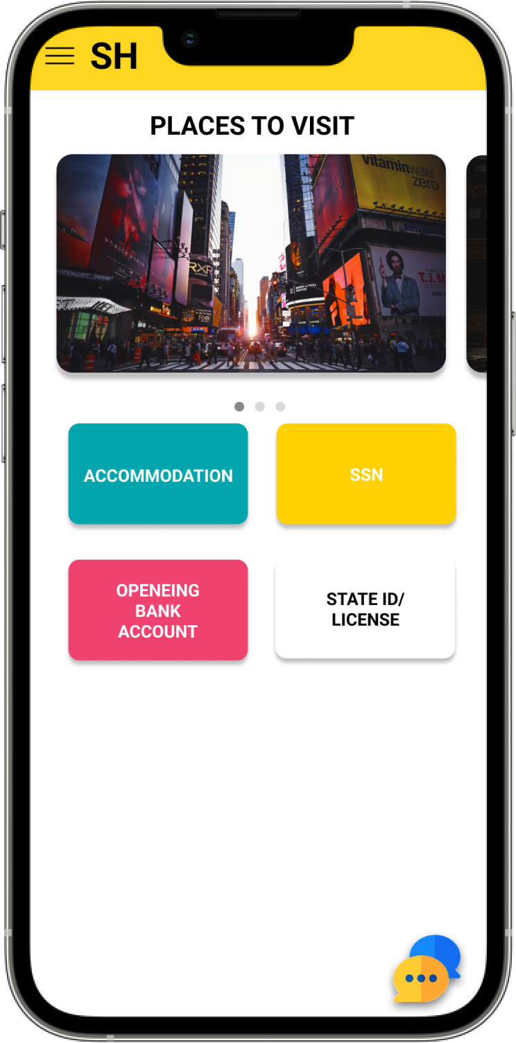
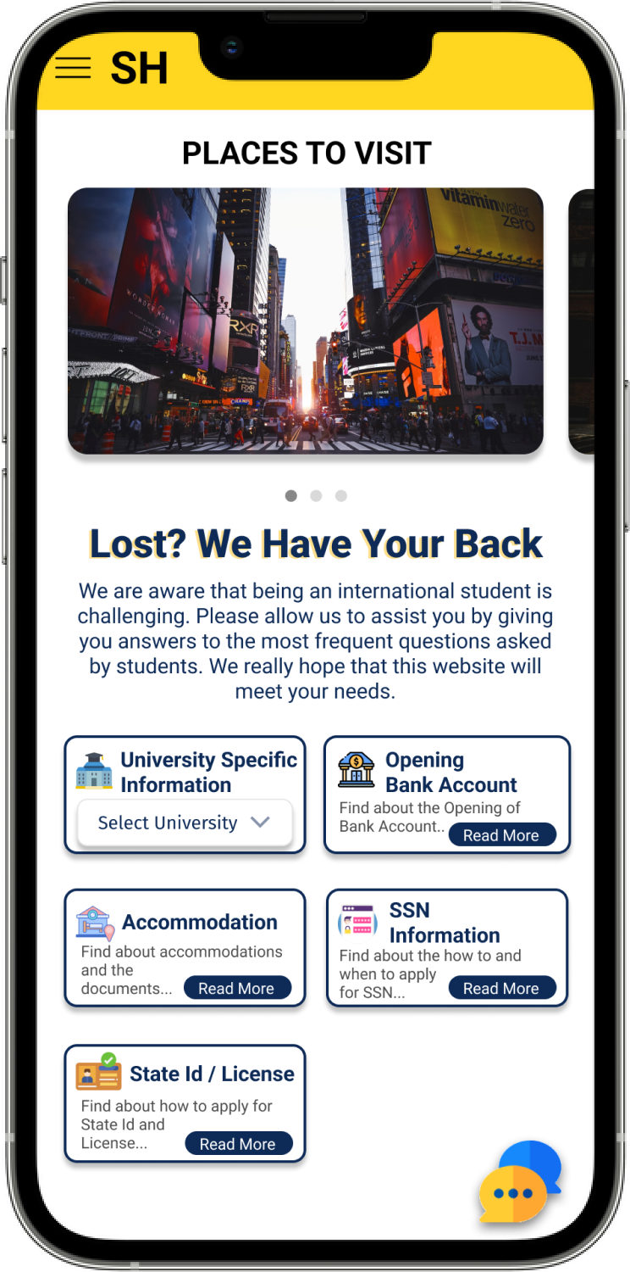
Mobile view changes
Prior To Changes
After Changes

Slide 36
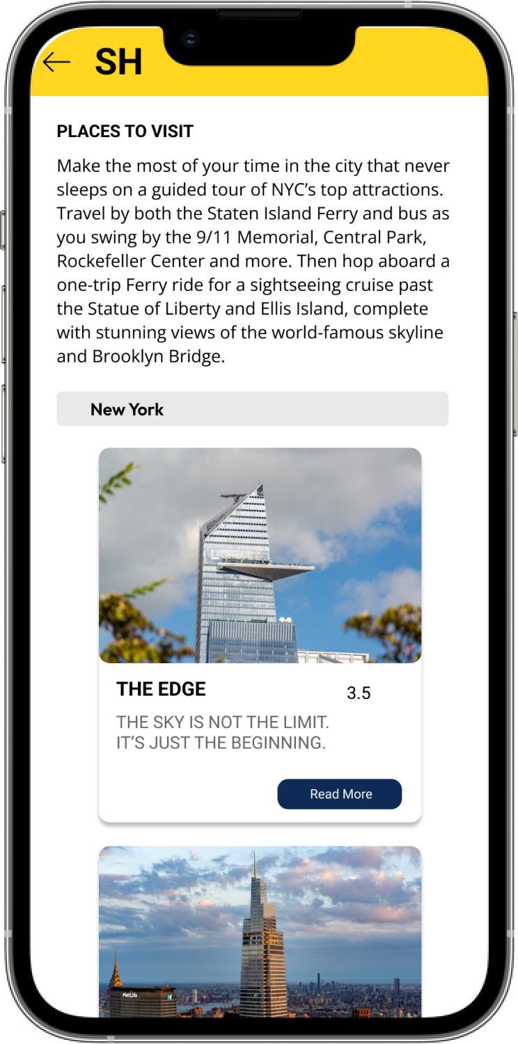
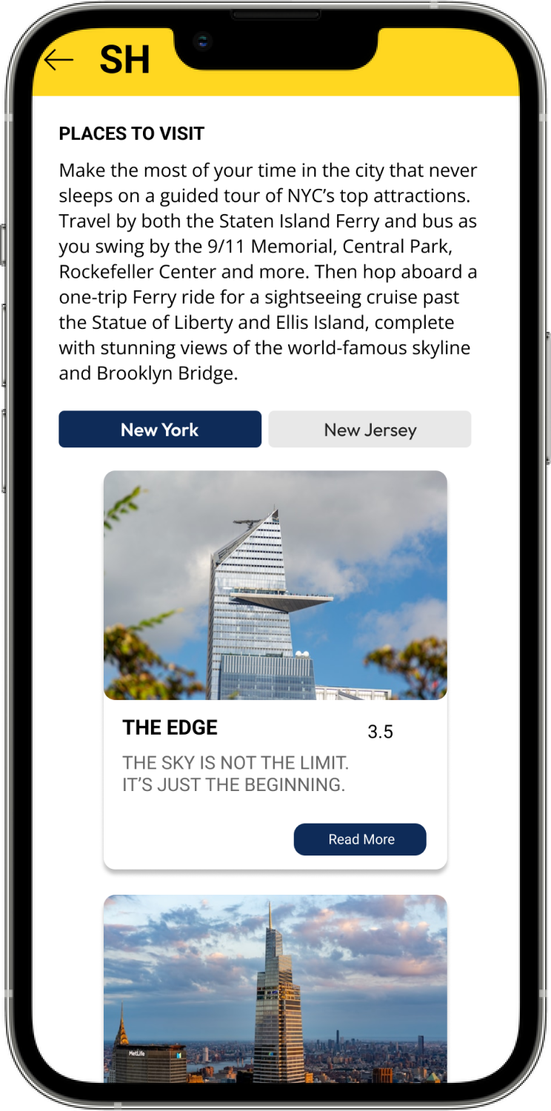
Mobile view changes
Prior To Changes
After Changes

Slide 37
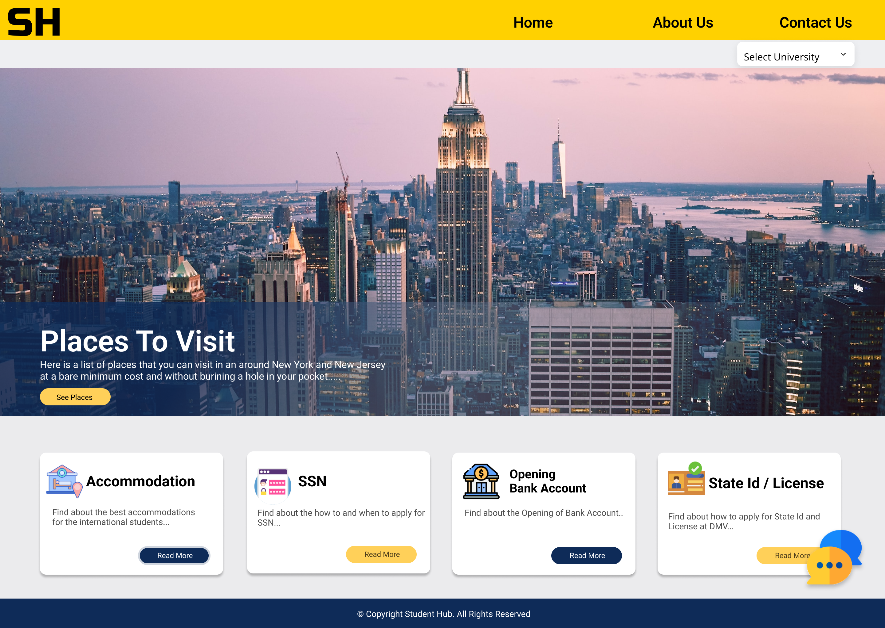
Website view changes
Prior To Changes
After Changes

Slide 38
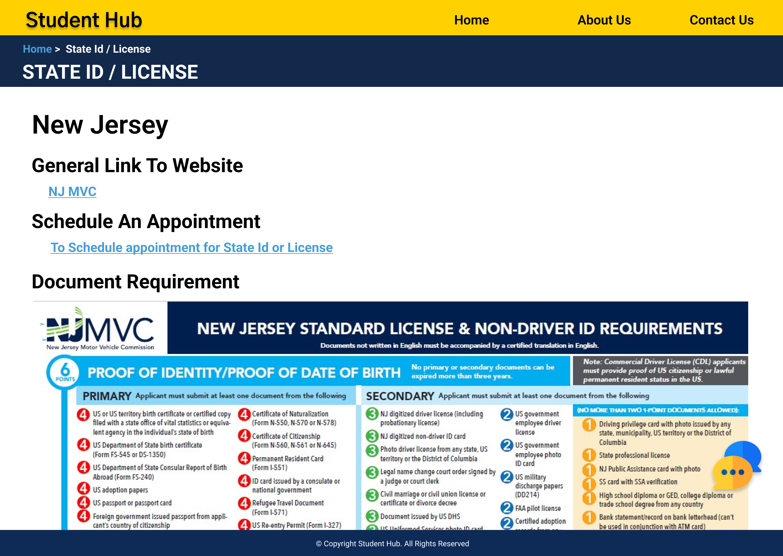
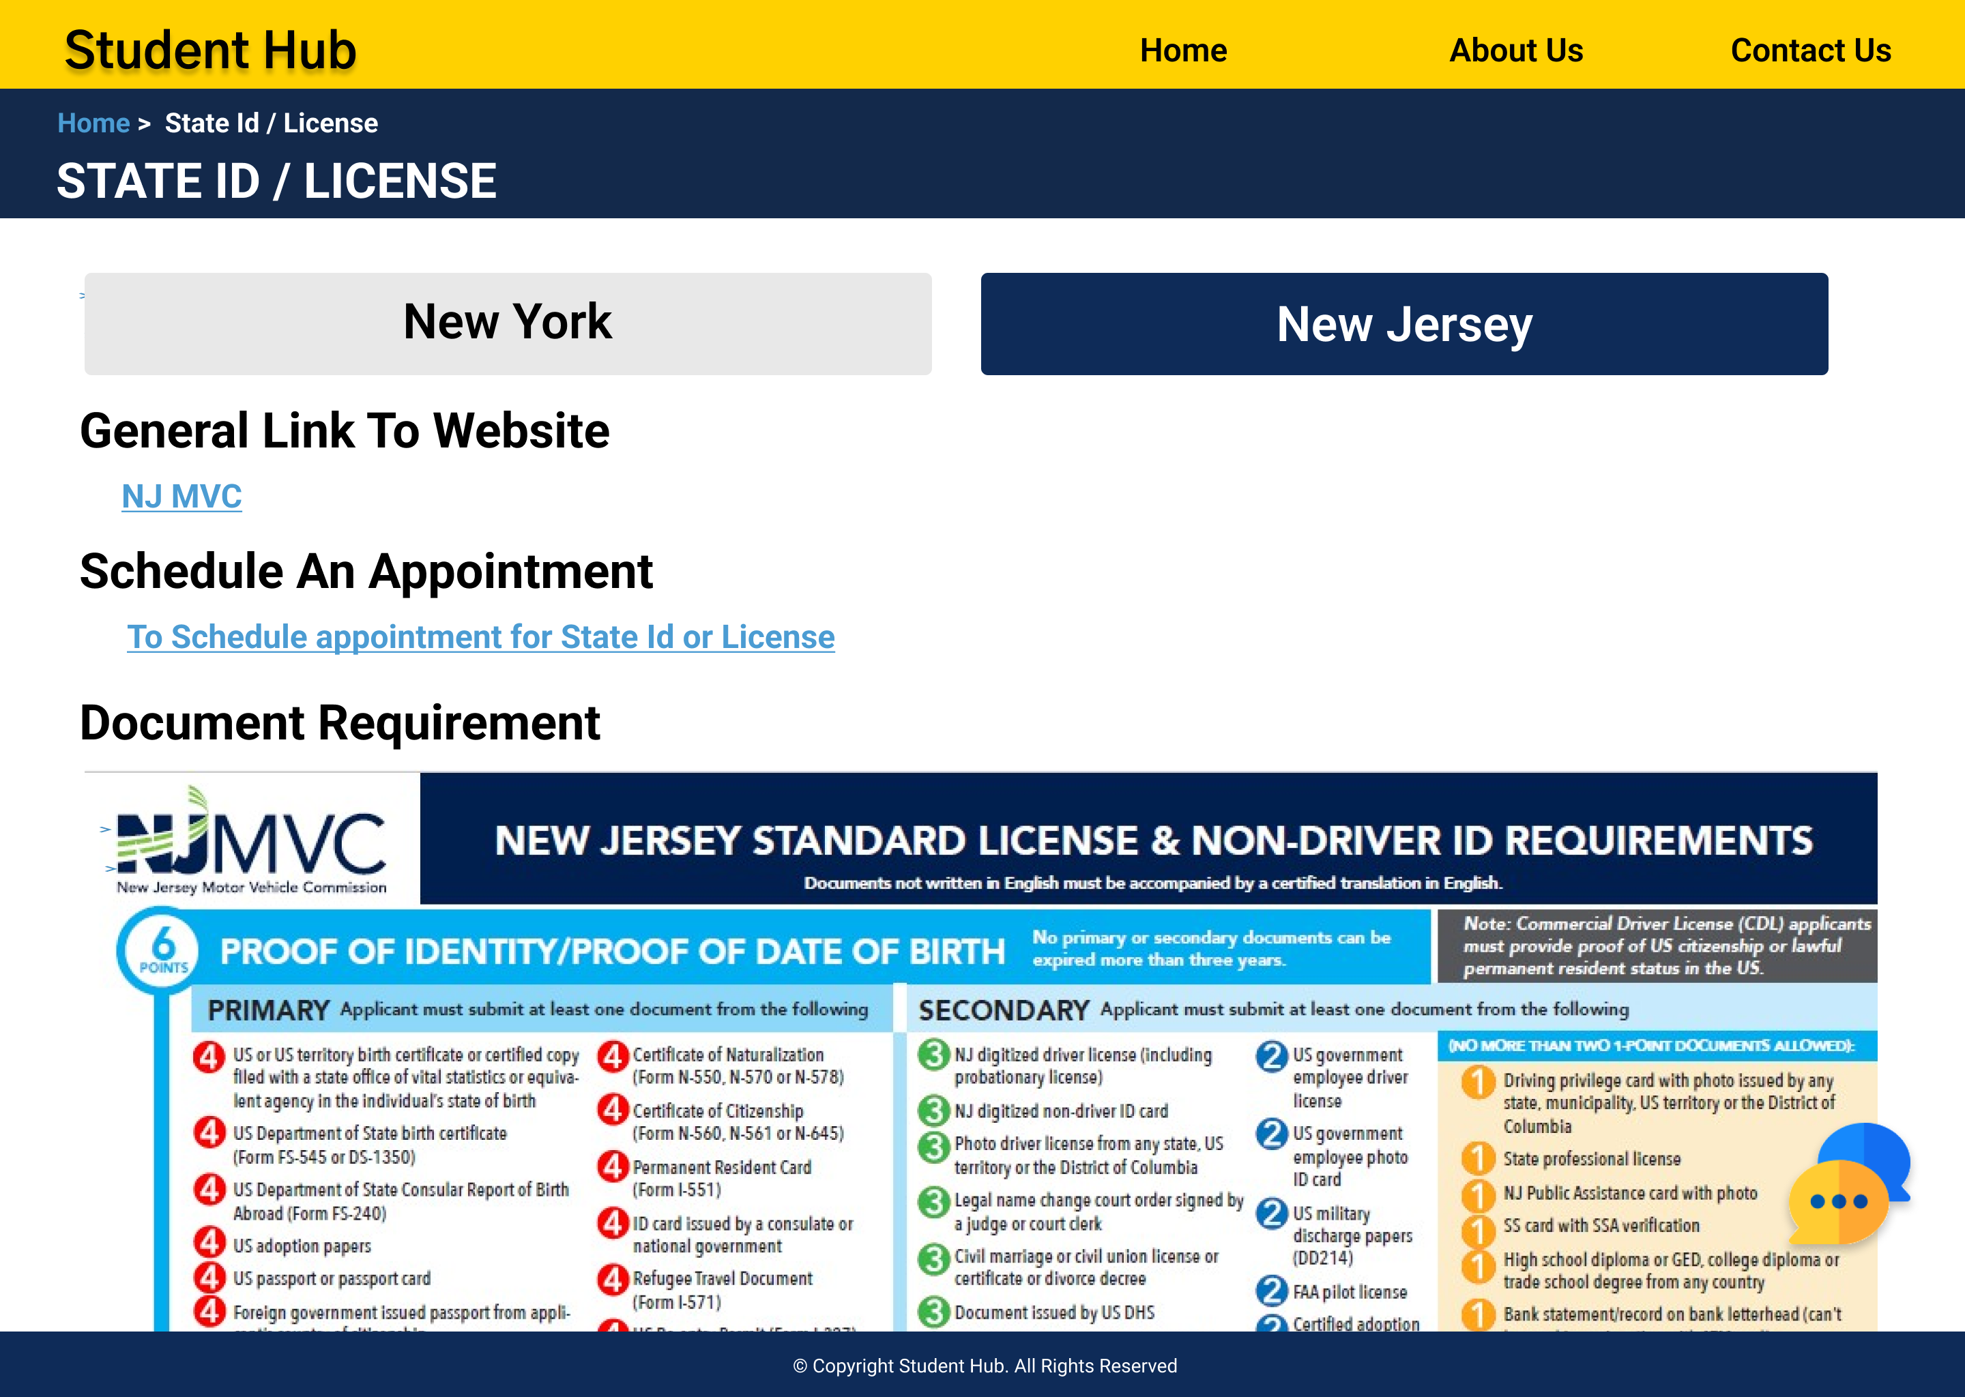
Website view changes
Prior To Changes
After Changes

Slide 39
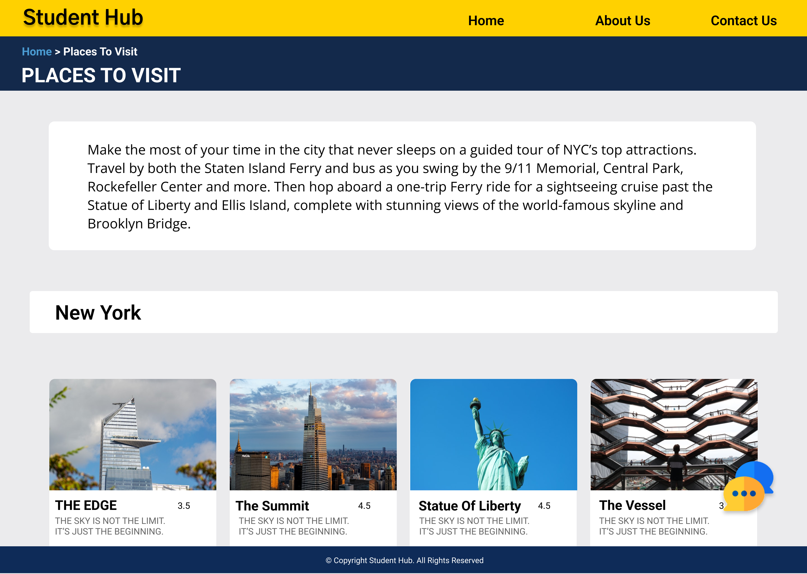

Website view changes
Prior To Changes
After Changes

Slide 40


Slide 41

Link:
StudentHub Link
Opening of Bank Account Section : More information to be provided in the page
personal touch of someone’s experience of doing that thing will explain things in a better way.
Love to see appointment slot booking feature.
Transferring money to university page to be added.
Loan process page to be added.
Users did enjoy the places to visit page and would love to see personal touch to it and user stories, of how they travelled through different places.
Accommodation: Accommodation verification parameters to be added, to guide incoming students more accurately.
Enhancing the pages with updated information.

Slide 42


